Slide 1
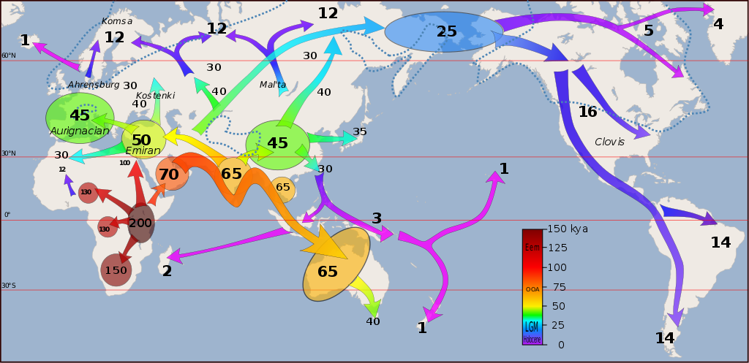
World to North America Selected Historical Events – See the Unseen
Source: https://commons.wikimedia.org/wiki/File:Early_migrations_mercator.svg

Slide 2
11,000 B.C.E. to 1640 C.E. Indigenous Settlement

Slide 3
11,000 B.C.E. to 1640 C.E. Indigenous Settlement
Not a wilderness…
“The Pre-Colombian Americas were laced together with a complex system of roads and paths which became the roadways adopted by the early settlers…”
“North America in 1492 was not a virgin wilderness but a network of Indigenous nations, peoples of the corn…they did not settle a virgin land. They invaded and displaced a resident population.”

Slide 4
11,000 B.C.E. to 1640 C.E. Indigenous Settlement
Not a wilderness…
“Since there is no evidence of corn on any other continent prior to its pre-Colombus dispersal, its development is a unique invention of the original American agriculturalists. Unlike most grains, corn cannot grow wild and cannot exist without attentive human care.”

Slide 5
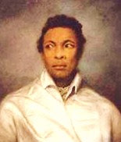
1492-1600: Early African Explorers
A navigator and explorer of African ancestry, Pedro Alonso Niño traveled with Christopher Columbus’ first expedition to the New World in 1492. Pedro Niño was the pilot of Columbus’ ship the “Santa Maria.”
Pedro Niño led his own expedition, financed by the Council of Castile, to find gold and pearls in areas not already discovered by Columbus.
He returned to Spain very wealthy but did not live up to an agreement he had with the King to turn over 20% of his treasure (known as “The Royal Fifth”). He was arrested and died in prison before his trial.

Slide 6
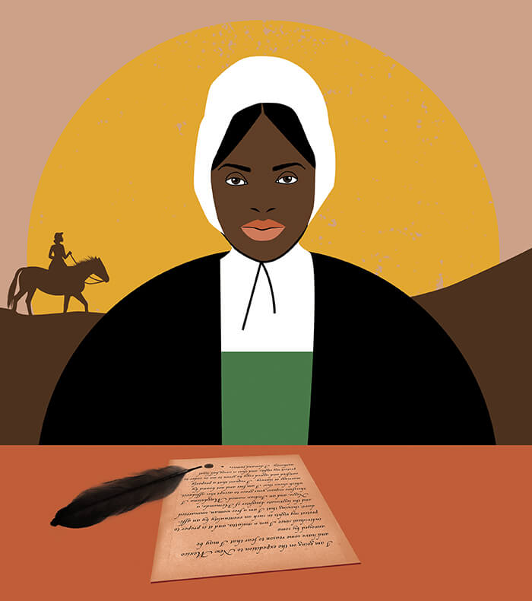
1492-1600: Early African Explorers
I am going on the expedition to New Mexico and have some reason to fear that I may be annoyed by some individual since I am a mulatta, and it is proper to protect my rights in such an eventuality by an affidavit showing that I am a free woman, unmarried and the legitimate daughter of Hernando, a Negro, and an Indian named Magdalena . . . . I therefore request your grace to accept this affidavit, which shows that I am free and not bound by marriage or slavery. I request that a properly certified and signed copy be given to me in order to protect my rights, and that it carry full legal authority. I demand justice.
- Isabel de Olvera, 1600

Slide 7
1540s-1900: Slave Trade active between Africa and Americas
By the conclusion of the trans-Atlantic slave trade at the end of the 19th century, Europeans had enslaved and transported more than 12.5 million Africans.
At least 2 million did not survive the journey.

Slide 8
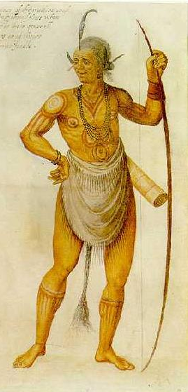
1550s-1640s: Powhatan Confederacy, Tsenacommaca
The Powhatan Confederacy was established under the leadership of Chief Wahunsonacock (Chief Powhatan). Chief Powhatan united more than 31 of the Virginia Indian tribal groups in the Tidewater region of what is now the Commonwealth of Virginia.
Chief Opechancanough launched a last major effort to expel the colonists on April 18, 1644, the third Anglo-Powhatan War. In 1646, Royal Governor William Berkeley captured Opechancanough, at the time believed to be between 90 and 100 years old.
They paraded him as a prisoner before a jeering crowd. The chief was killed by a soldier, who shot him in the back. Before dying, the chief reportedly said, "If it had been my fortune to take Sir William Berkeley prisoner, I would not have meanly exposed him as a show to my people."
1585 painting of a Chesapeake Bay warrior by John White adapted to represent Opechancanough (1554–1646), a tribal chief within the Powhatan Confederacy of what is now Virginia in the United States. He was the younger brother (or possibly half-brother) of Chief Powhatan, who had organized and dominated the Powhatan Confederacy.

Slide 9
1607: Jamestown colony established in Virginia
Jamestown colony established in Virginia, first permanent English colony formed in North America by the Virginia Company.

Slide 10
c1595-1617: Pocahontas
c1595: Pocahontas, or Amonute and Matoaka, born
1609–10: Jamestown is decimated in the Starving Time. Around 60 of the 500 English colonists survive
1613: Pocahontas taken prisoner by the English captain Argall and taken to Jamestown
1614: Pocahontas marries John Rolfe and becomes known as Lady Rebecca
1617: Pocahontas dies. Tensions escalate between the Jamestown colonists and Powhatan tribes
1622: Approximately a third of the settlers in Virginia were killed by Powhatan forces. The colony eventually rebounded and later killed hundreds of Native people in retaliation, including many warriors poisoned by Dr. John Potts at Jamestown.
Pocahontas and her son, Thomas Rolfe in the Sedgeford Portrait, reproduced in 1887. Pocahontas (c. 1595- 21 March, 1617), daughter of Chief Powhatan. Thomas Rolfe (30, January, 1615- c. 1675) was their only son. Source: https://www.gettyimages.com/detail/news-photo/pocahontas-and-thomas-rolfe-in-the-sedgeford-portrait-news-photo/173312181?adppopup=true

Slide 11
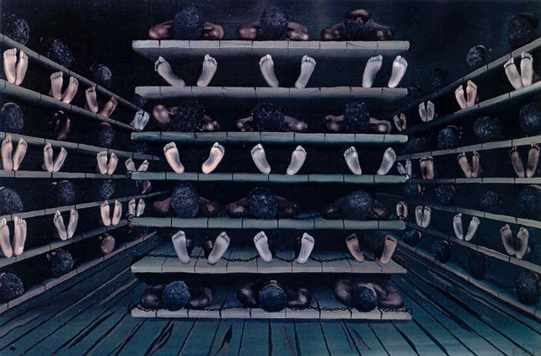
1619: First enslaved people arrive in what is now the United States
August 1619, Jamestown colonists bought 20 to 30 enslaved Africans from English pirates.
Those men and women who came ashore on that August day were the beginning of American slavery.
Source: https://datavizblog.com/2013/03/09/dataviz-history-the-slave-ship-chart-that-kindled-the-abolitionist-movement-1788/ Image: Library of Congress / Science Photo Library. First published in Eye no. 82 vol. 20.

Slide 12
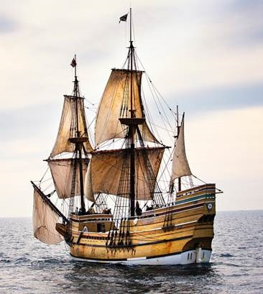
1620: Mayflower lands at Cape Cod
Puritans arrive to establish the Plymouth colony

Slide 13
1670s: Settler Militia Scalp-hunts
Where did the term ‘Redskins’ come from?
“During the Pequot War, Connecticut and Massachusetts colonial officials had offered bounties for the heads of murdered Indigenous people and later for only their scalps, which were more portable in large numbers.
… Although the colonial government in time raised the bounty for adult male scalps, lowered that for adult female scalps, and eliminated that for Indigenous children under ten, the age and gender of victims were not easily distinguished… Bounties for Indigenous scalps were honored even in absence of war.
Scalps and Indigenous children became a means of exchange, currency… The settlers gave a name to the mutilated and bloody corpses they left in the wake of scalp-hunts: redskins.”

Slide 14
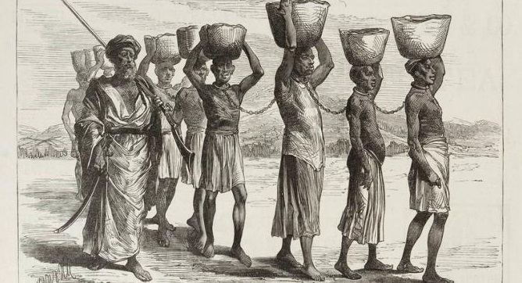
1705 Virginia Assembly Defines Slavery
The Virginia General Assembly defined some terms of slavery in 1705:
“All servants imported and brought into the Country ... who were not Christians in their native Country ... shall be accounted and be slaves. All Negro, mulatto and Indian slaves within this dominion ... shall be held to be real estate. If any slave resists his master ... correcting such slave, and shall happen to be killed in such correction ... the master shall be free of all punishment ... as if such accident never happened.”

Slide 15
1754: Petition Against Alcohol
A Catawba leader known as King Hagler by English colonists petitioned the North Carolina authorities:
Brothers, here is one thing you yourselves are to blame very much in; that is you rot your grain in tubs, out of which you take and make strong spirits. You sell it to our young men and give it [to]them, many times; they get very drunk with it [and] this is the very cause that they oftentimes commit those crimes that is offensive to you and us and all through the effect of that drink…”

Slide 16
1760: Settlers Target Non-combatants
“In Case a War must be proclaimed, the three Southern Provinces of Virginia and the Carolinas should exert their whole force, enter into and destroy all the [Cherokee] Towns of those at War with us, and make as many of them as we should take their Wives and Children Slaves, by sending them to the Islands [West Indies] if above 10 years old…”
-- Governor of North Carolina

Slide 17
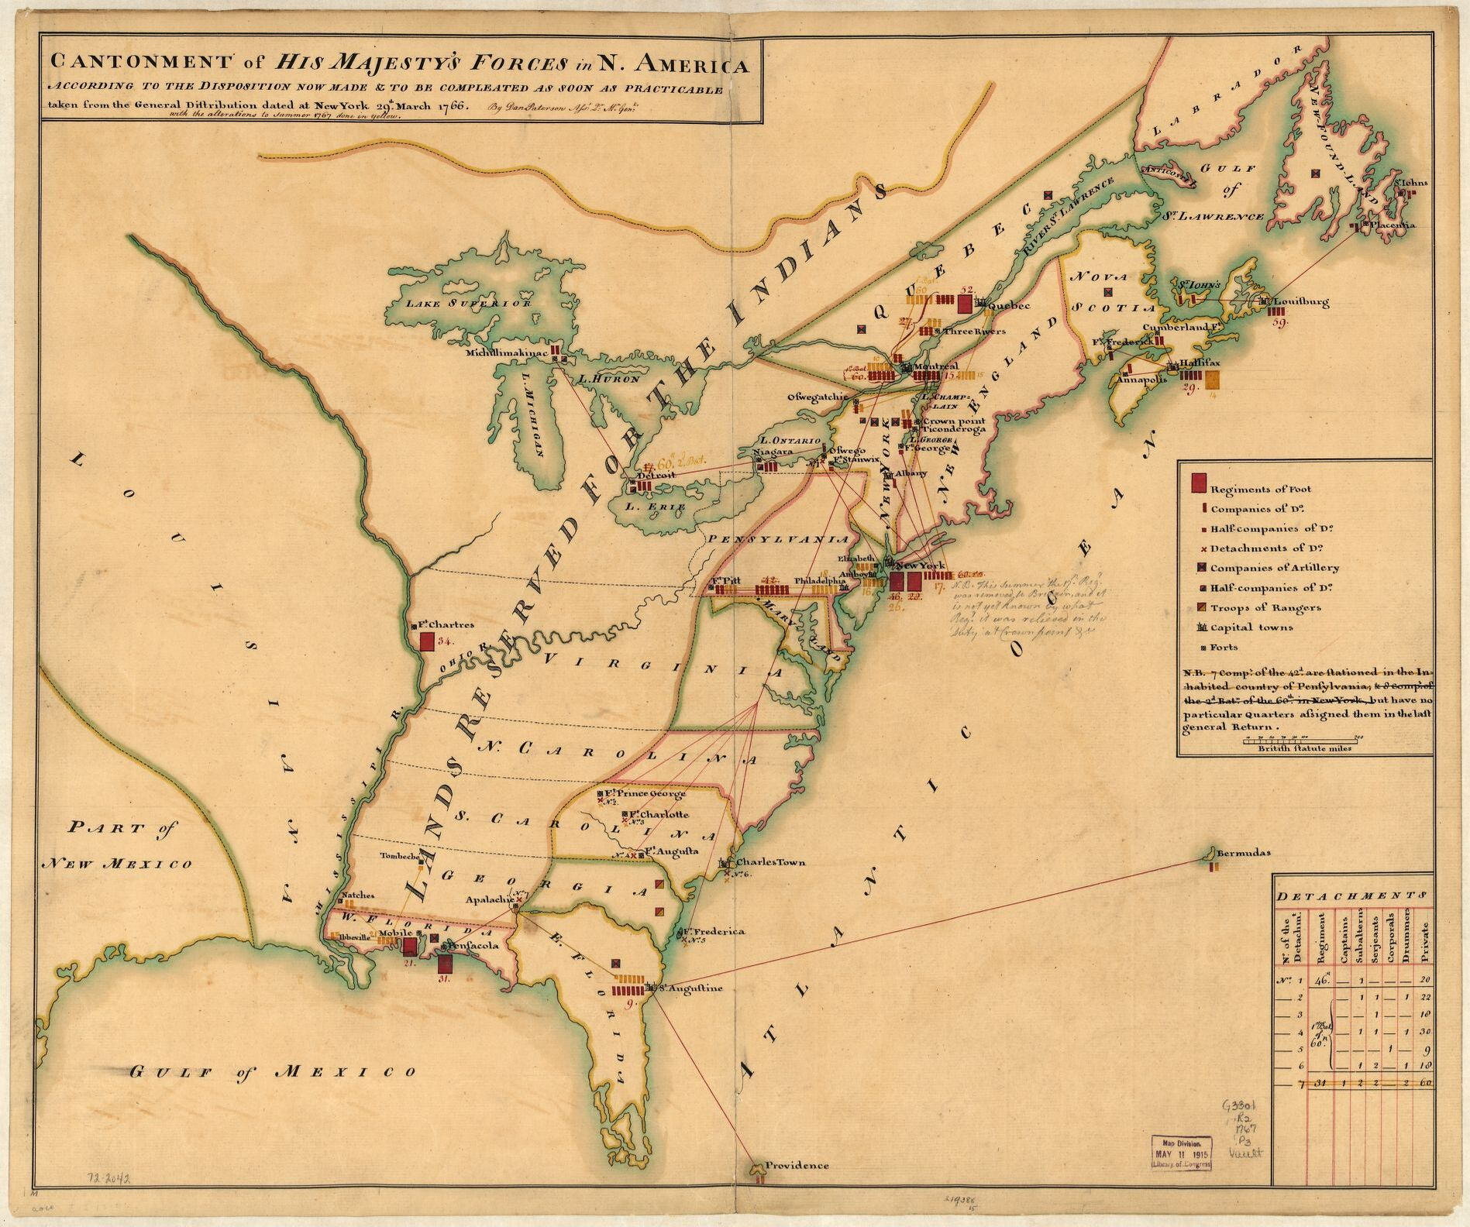
1763: Royal Proclamation forbade all settlement west of the Appalachians
The Royal Proclamation of 1763 was issued by King George III on October 7, 1763, following Great Britain's acquisition of French territory in North America after the end of the Seven Years' War. It forbade all settlement west of the Appalachian Mountains, which was delineated as an Indian Reserve. British desire was to avoid an expensive Anglo-Indian war to protect settlers from attacks by tribes.
Source: Library of Congress Geography and Map Division

Slide 18
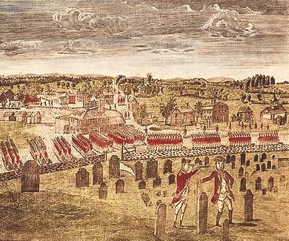
1763-1783: American Revolutionary War
Around 1750, the British mainland American colonies had a population of approximately 1.5 million. German immigrants began to arrive and between 1749 and 1754, more than 5,000 Germans arrived annually.
Each year 3,500 black captives arrived from Africa or the Caribbean. Nearly 1 in 5 Americans, or 300,000 people, were enslaved. Poverty in Northern Ireland forced a massive flight of Scots-Irish to the colonies.
Some colonists began to agitate for their independence. This led to the American Revolution, with its ethos of freedom and equality.
African Americans began a parallel struggle for their own freedom.
Dragging Canoe and "Chickamauga Cherokees" fought for Cherokee land and independence 1776-1792. Cherokee fought on the side of the British during the war.
The British Army in Concord, April 19, 1775. Source: New York Public Library Collection.

Slide 19
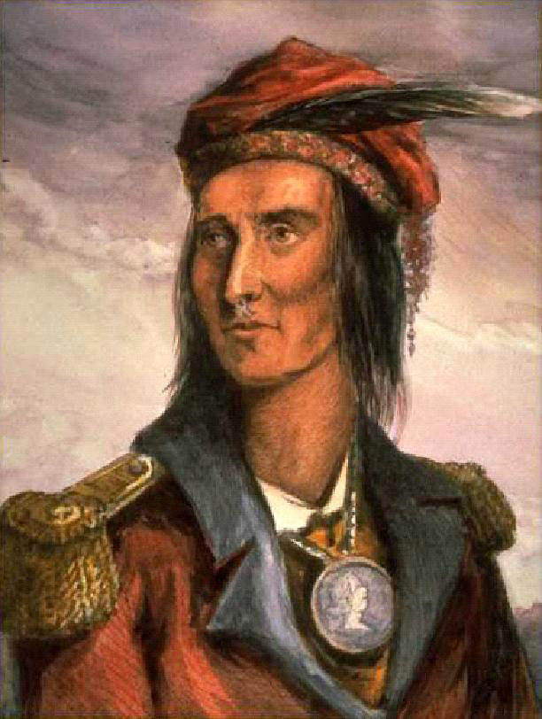
1768-1813: Tecumseh, Shawnee warrior chief
Primary leader of large-scale confederacy of Native Americans
War of 1812 broke out in June; Tecumseh and his supporters joined the British. U.S. General William Hull and about 2,000 men invaded Canada from Detroit. They were quickly repelled due to Tecumseh’s interception of a supply train.
Tecumseh participated in failed sieges of two forts in Ohio. He then reluctantly retreated with the British back into Canada.
U.S. troops caught up with the British and Native Americans along the Thames River, winning a battle there that cost Tecumseh his life.
The surviving Shawnee divided into groups and dispersed in various directions. Most eventually ended up in Oklahoma.
Source: Toronto Public Library

Slide 20
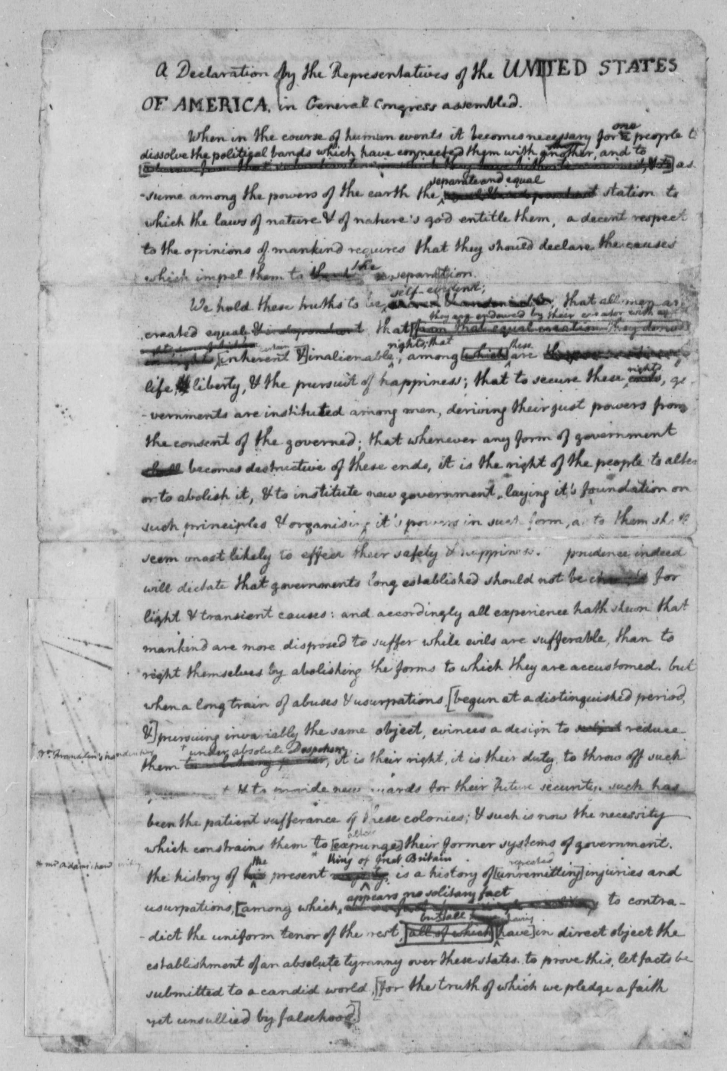
1776: Thomas Jefferson writes first draft of Declaration of Independence
When Thomas Jefferson included a passage attacking slavery in his draft it initiated the most intense debate among the delegates.
He wrote all men are "endowed by their creator with inherent and inalienable rights." The "inherent," implying independence is something all are born with, even slaves.
This was removed from the final version.
Original rough draft in Jefferson’s handwriting. Source: Library of Congress

Slide 21
Source: Victor van Werkhooven, en.Wikipedia.org

Slide 22
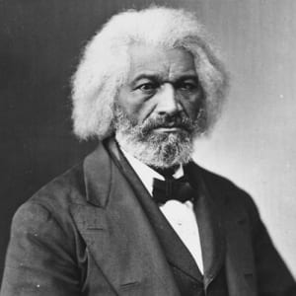
1818-1895: Frederick Douglass
Frederick Douglass (born Frederick Augustus Washington Bailey) was an American social reformer, abolitionist, orator, writer, and statesman.
After escaping from slavery in Maryland, he became a national leader of the abolitionist movement in Massachusetts and New York, gaining note for his oratory and incisive antislavery writings.
Douglass was a firm believer in the equality of all peoples, whether white, black, female, Native American, or Chinese immigrants. He was also a believer in dialogue and in making alliances across racial and ideological divides, and in the liberal values of the U.S. Constitution.
Source: Library of Congress

Slide 23
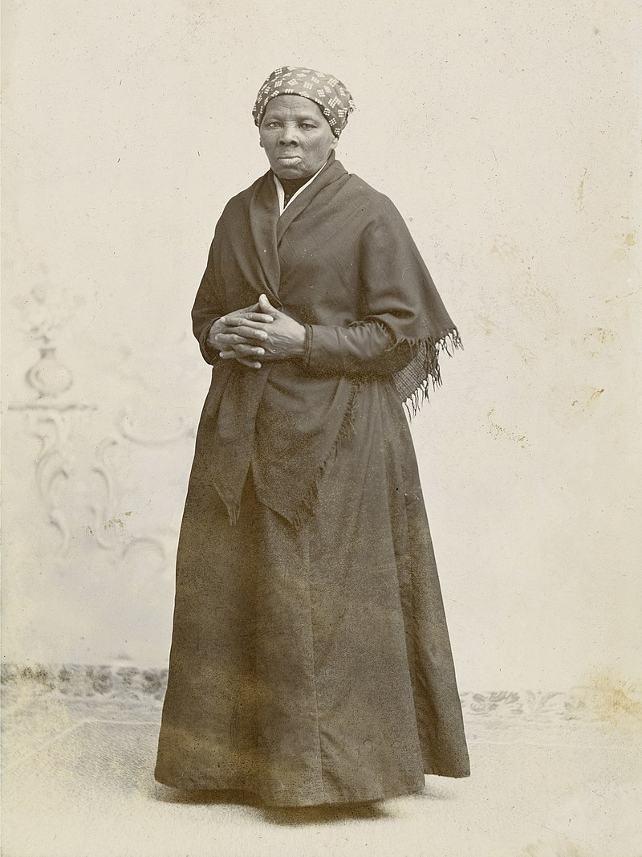
1822-1913: Harriet Tubman
Harriet Tubman (born Araminta Ross) was an American abolitionist and political activist. Born into slavery, Tubman escaped and subsequently made some 13 missions to rescue approximately 70 enslaved people, on the Underground Railroad.
During the American Civil War, she served as an armed scout and spy for the Union Army. In her later years, Tubman was an activist in the struggle for women's suffrage.
Source: Horatio Seymour Squyer, National Portrait Gallery

Slide 24
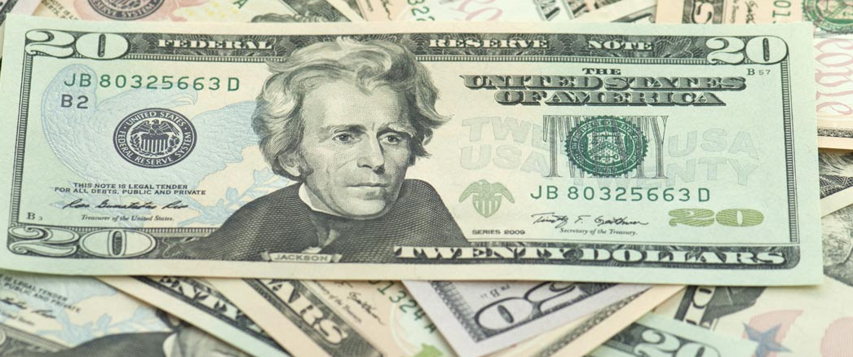
1828-1830s: Andrew Jackson elected President; Indian Removal Act passed 1830
Andrew Jackson was elected President in 1828; he campaigned on a platform of Indian Removal.
Jackson prospered as planter, slave owner, and merchant. Jackson may have owned as many as 300 slaves. At various times he posted advertisements for fugitive slaves who had escaped from his plantation. In one advertisement in October 1804, Jackson offered "ten dollars extra, for every hundred lashes any person will give him, to the amount of three hundred."
Andrew Jackson has been featured on the $20 bill since 1928.

Slide 25
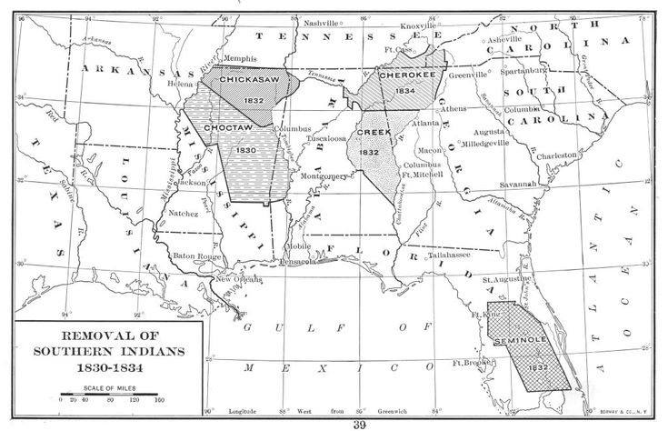
1832: Cherokees declared sovereign
The United States Supreme Court decided in favor of the Cherokees, declaring them a sovereign nation.
Although the Court ruled in favor of the Cherokee, Georgia ignored the decision and in 1838 the Cherokee were forcibly relocated to present-day Oklahoma.
Source: Interim Archives/Getty Images

Slide 26
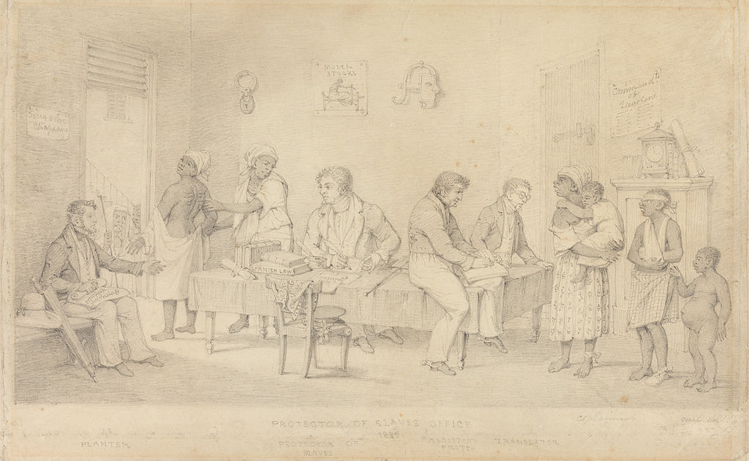
1834: Slavery abolished in Britain
Slavery Abolition Act abolished slavery in most British colonies, freeing more than 800,000 enslaved Africans in the Caribbean and South Africa as well as a small number in Canada.
Protector of Slaves Office (Trinidad), 1838. Source: Paul Mellon Collection, Yale Center for British Art, Yale University

Slide 27
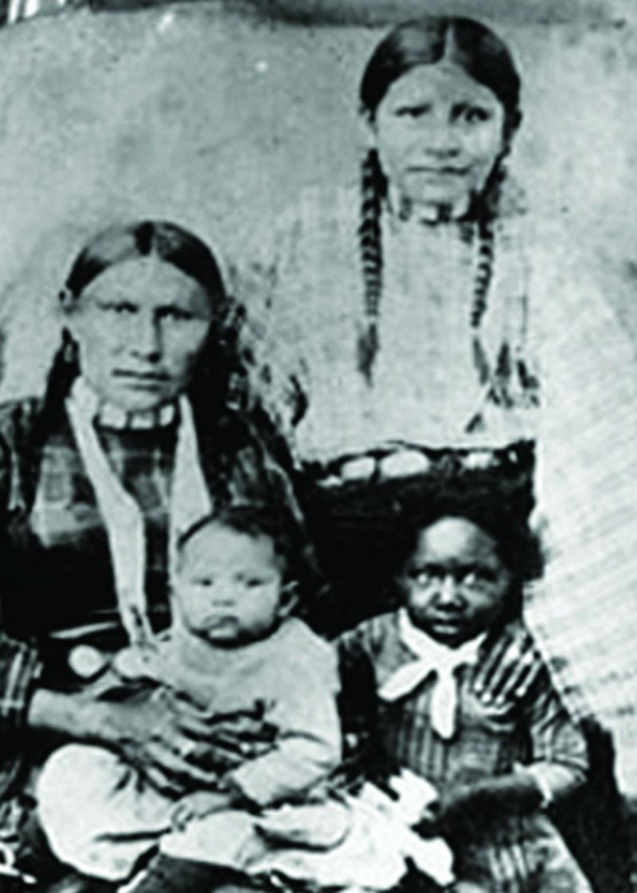
1838: Cherokee removal began
Cherokee people were herded into stockades, forced on boats and to march overland.
Between May 1838 and March 1839 about 16,000 Cherokees were removed.
At least 4,000 died, and many were buried in unmarked graves.
Source: Denver Public Library, Soule View Artist, 1886.

Slide 28
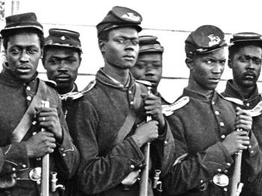
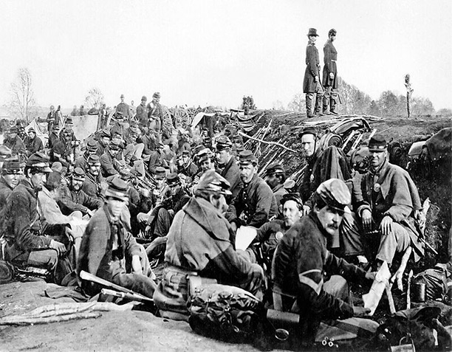
1861-1865: American Civil War
Eleven states seceded to form the Confederate States of America spurred by the election of President Abraham Lincoln in November 1860
For Northern states, war was fought to restore unity and to secure the new Western Territories from slave owners.
For the Southern Confederate states, war was to assert their autonomous rights.
At the heart of the conflict was the issue of slavery.
Source: Historyonthenet.com

Slide 29
1863: Emancipation Proclamation
Although the Emancipation Proclamation did not end slavery in the nation, it fundamentally transformed the character of the war.
After January 1, 1863, every advance of federal troops expanded the domain of freedom.
It announced the acceptance of black men into the Union Army and Navy. By the end of the war, almost 200,000 black soldiers and sailors had fought for freedom.
From the first days of the Civil War, slaves had acted to secure their own liberty. The Emancipation Proclamation confirmed that the war for the Union must become a war for freedom.
Source: Library of Congress

Slide 30
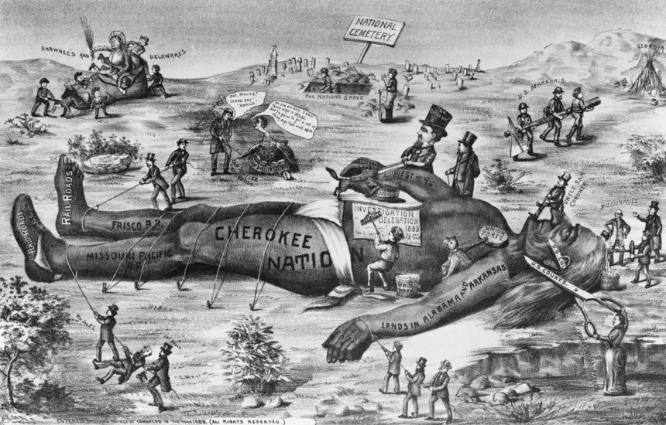
1869: Transcontinental railroad complete; wild buffalo exterminated; war on Native Americans intensifies
“The great Pacific Railway is commenced… Immigration will soon pour into these valleys. Ten millions of emigrants will settle in this golden land in twenty years… This is the grandest enterprise under God!”
- George Francis Train, railroad financer

Slide 31
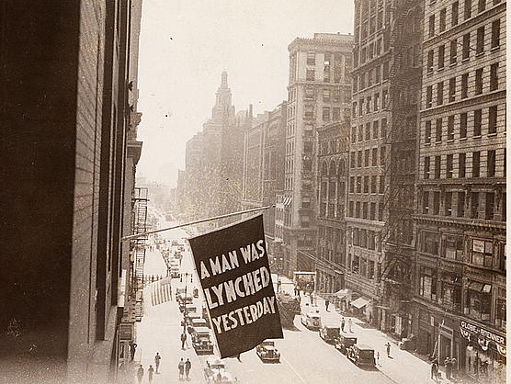
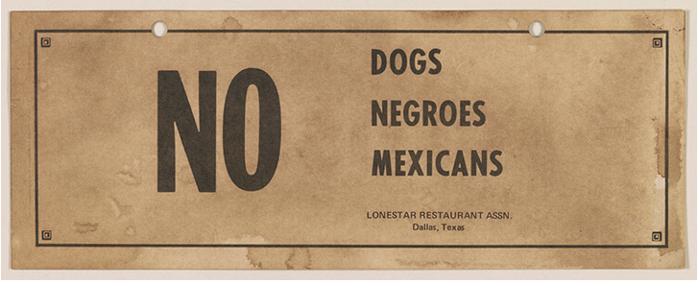
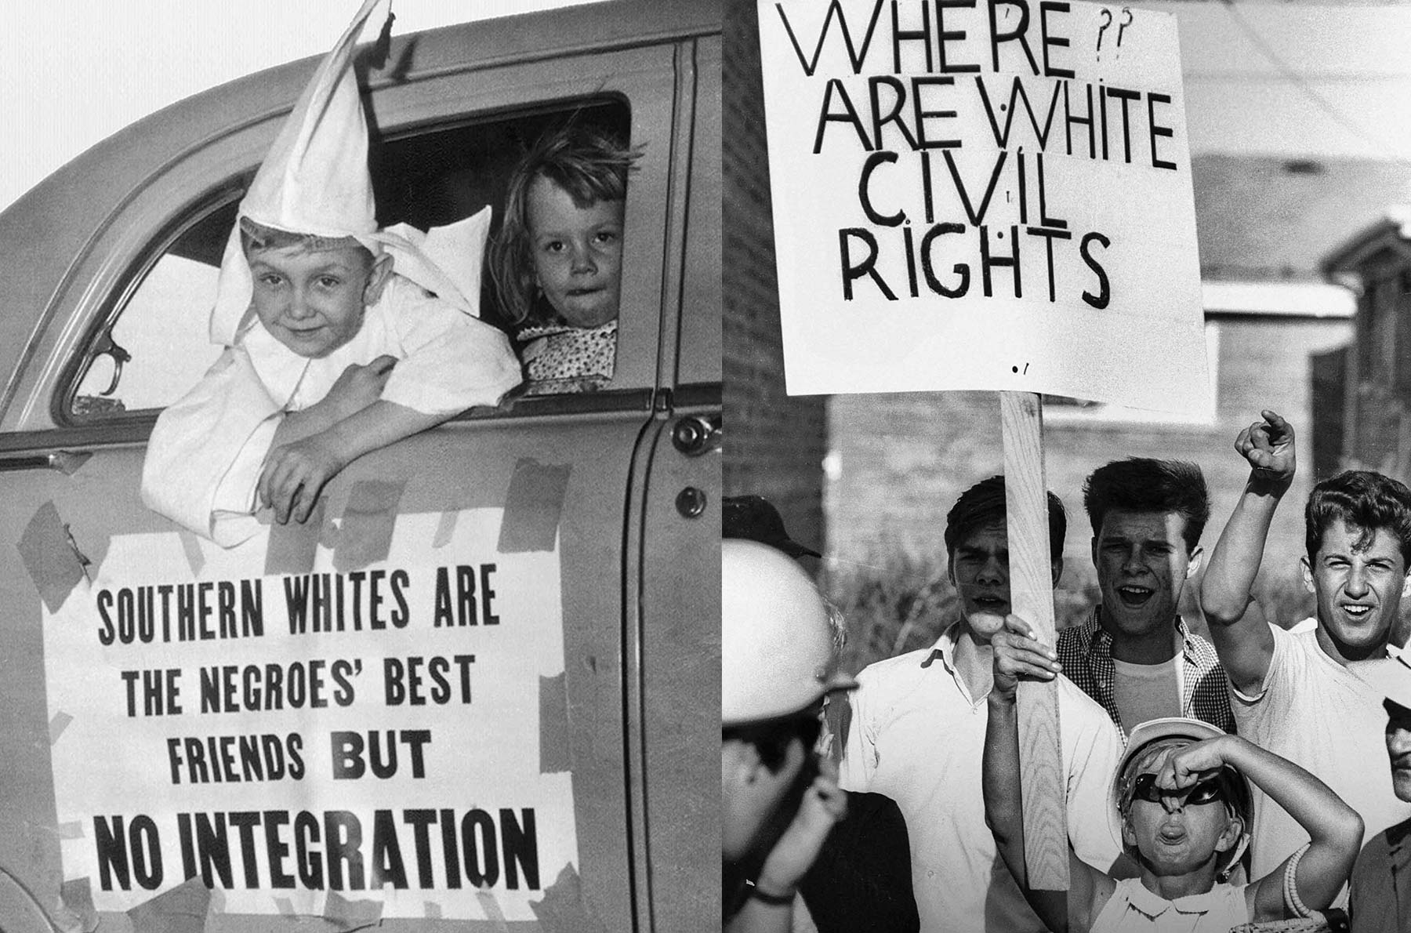
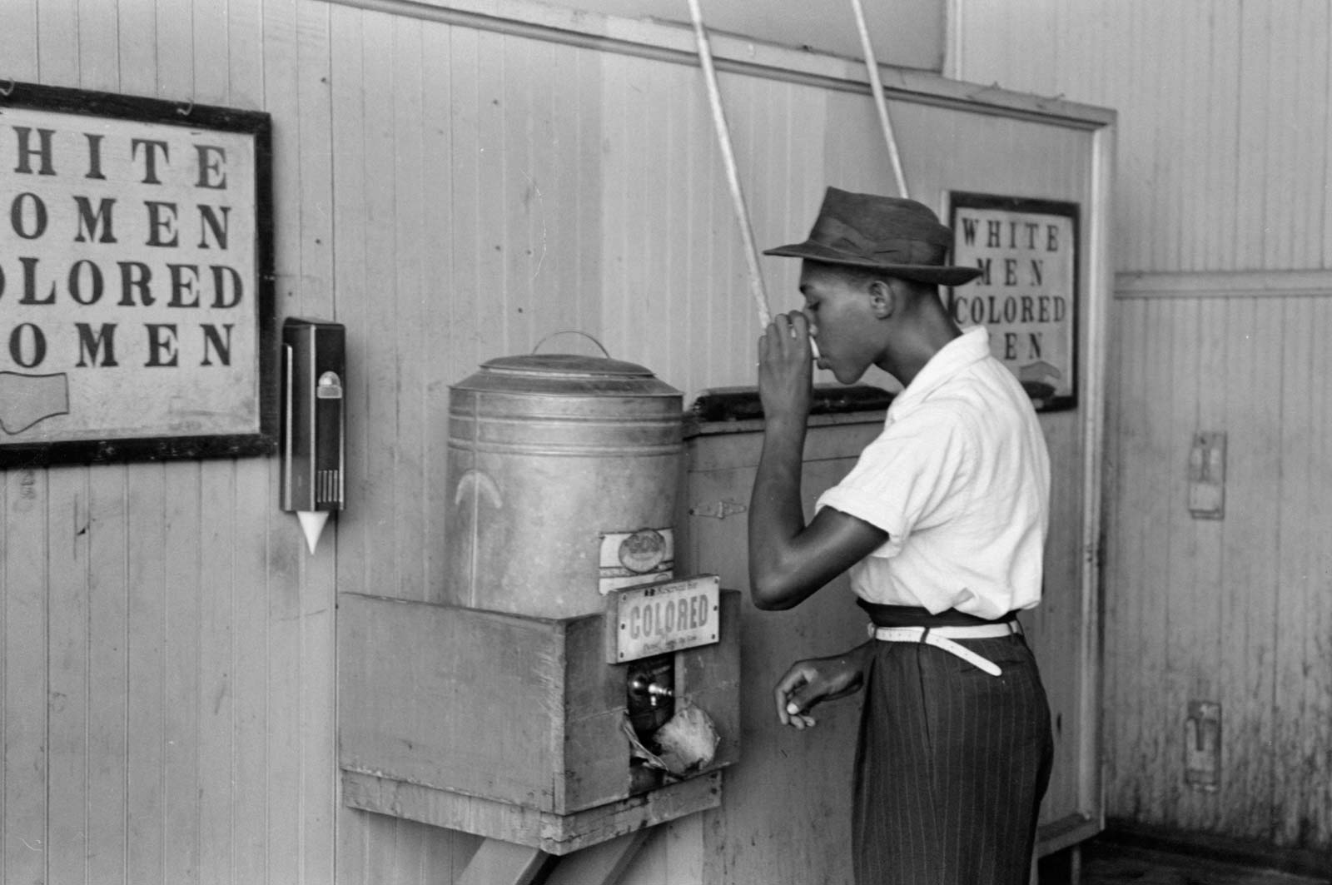
1865-1968: Segregation Era
Source: Black History Collection, Manuscript Division, Library of Congress
Source: Russell Lee/Library of Congress, Oklahoma City, 1939
Source: Seven-year-old dressed in Ku Klux Klansman robes rides in a Klan motorcade on August 14, 1956, in Macon, Georgia. (Bettmann/Getty Images); White children protest desegregation in Chicago, Illinois, 1966. (Declan Haun/Chicago History Museum)

Slide 32
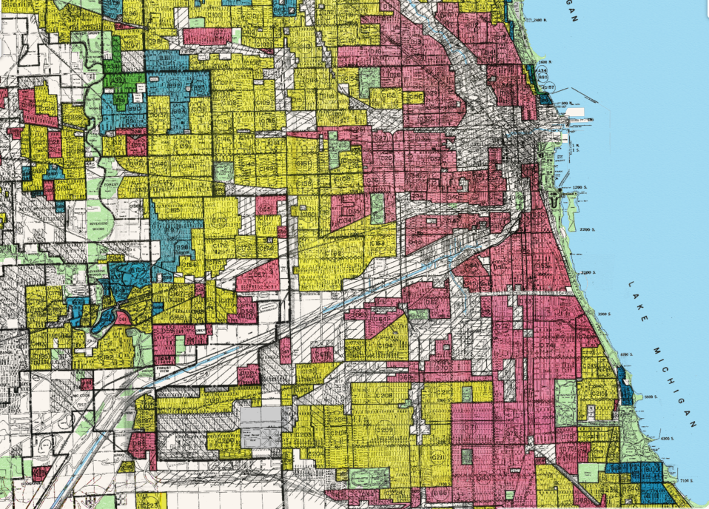
1917-2015: Segregation persists
In 1917, the U.S. Supreme Court ruled that the government could not enforce racial zoning.
About 50 years later, the Fair Housing Act outlawed racial discrimination.
It took another 50 years for the Supreme Court to decide in 2015 that policies that implicitly affected minorities were also unconstitutional.
“Economic segregation in housing is damaging, and perhaps even as insidious as outright racial segregation, because while in effect it still excludes substantial numbers of people of color from good places to live, it does so with the open consent of the law.”

Slide 33
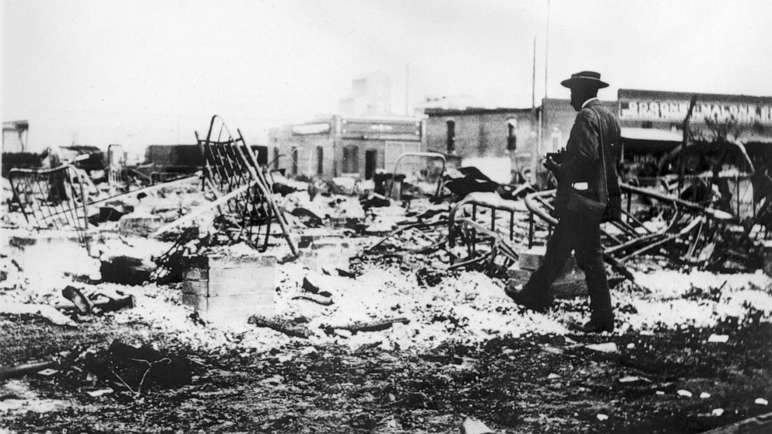
1921: Tulsa Race Massacre
The Tulsa massacre, Greenwood Massacre, or the Black Wall Street Massacre, when mobs of white residents attacked black residents and businesses of the Greenwood District in Tulsa, Oklahoma.
It has been called "the single worst incident of racial violence in American history." The attack, carried out on the ground and from private aircraft, destroyed more than 35 square blocks of the district, the wealthiest black community in the US, known as "Black Wall Street".
Many survivors left Tulsa. Black and white residents who stayed in the city were silent for decades about the terror, violence, and losses of this event. The riot was largely omitted from local, state, and national histories.
A man with a camera looks at the skeletons of iron beds above the ashes of a burned-out block after the Tulsa Race Riot, Tulsa, Oklahoma, 1921. Source: Oklahoma Historical Society/Getty Images

Slide 34
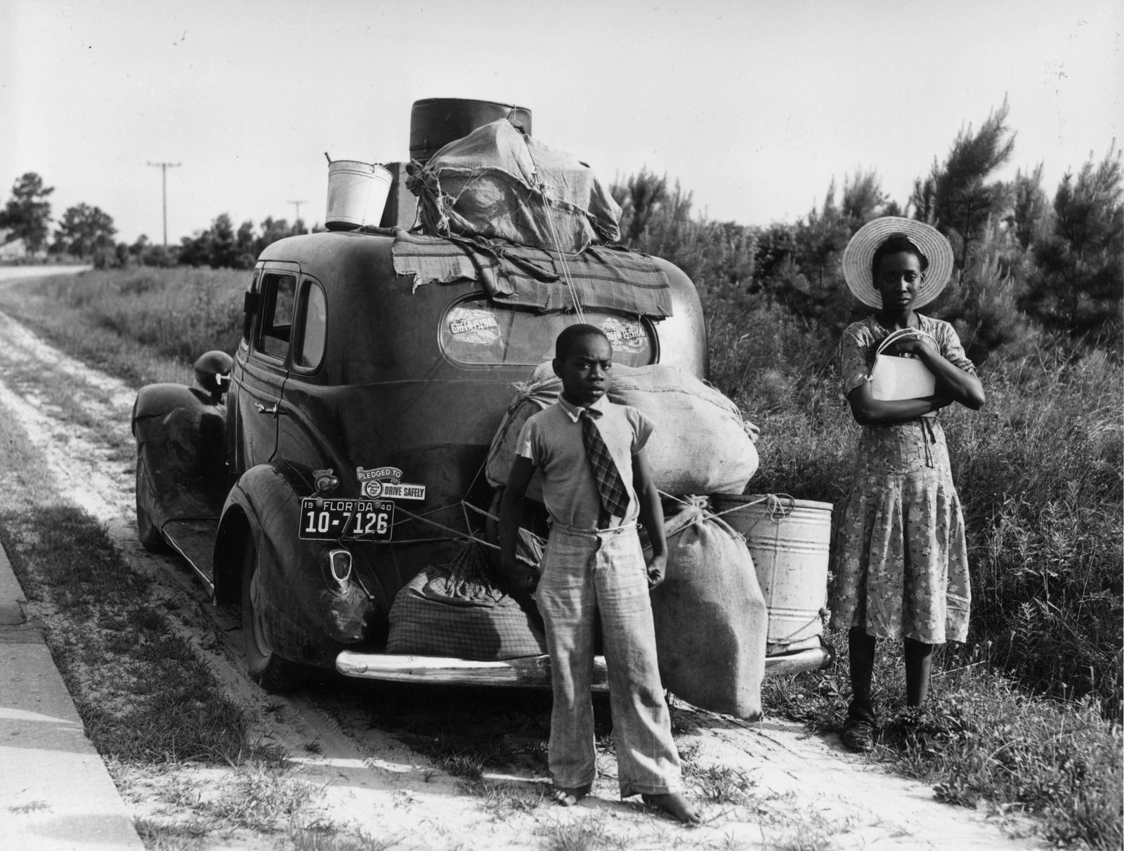
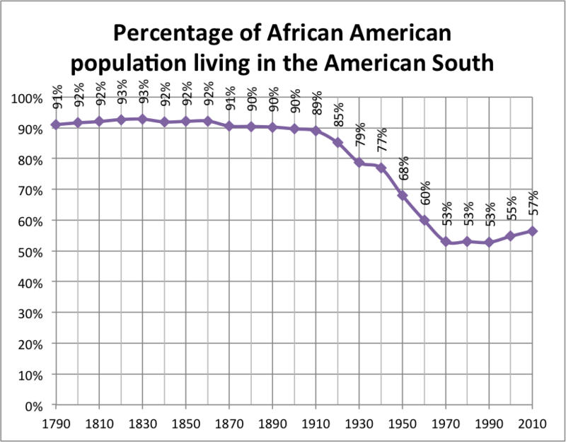
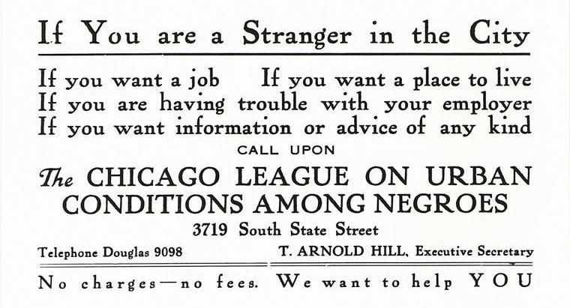
1916-1968: “Great Migration” African Americans flee northwards
“They left as though they were fleeing some curse… they were willing to make almost any sacrifice to obtain a railroad ticket and they left with the intention of staying.” - Wrote scholar Emmett J. Scott, an observer of the early years of the migration
Graph showing the percentage of African American population living in the American South, 1790-2010. Source: wikipedia
As migrants filled Northern factories, groups offering social services handed out advertising cards. Source: University of Illinois at Chicago. The University Library, Special Collections Department, Arthur and Graham Aldis Papers.

Slide 35
Omari Richins​ on Slavery & Colonialism
"You can look back at your history and know where your family has come from... I can't do that."
Notes:
Omari Richins is a social worker from Trinidad and Tobago who lives in the Mat-Su Valley. In this clip he reflects on the legacy of slavery and colonialism.

