Slide 1
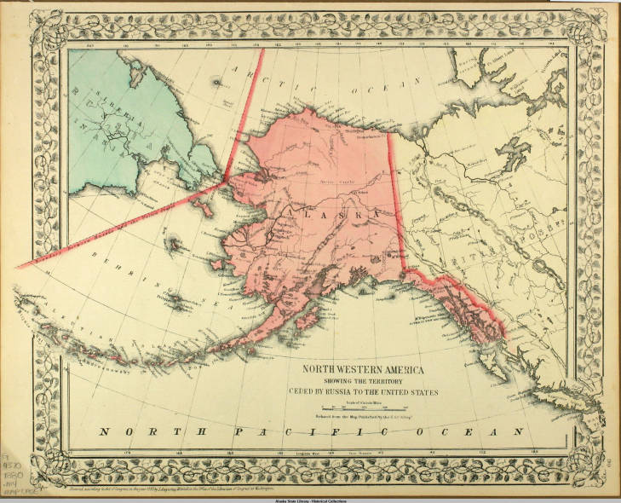
Alaska
Selected historical events – See the unseen
1880 map showing land sold from Russia to America.
Source: Alaska State Library

Slide 2
25,000 B.C.E. to present
Human presence arrives in area now known as Alaska.
As peoples settle across Alaska, diverse languages, cultural practices, settlement patterns, technologies develop.

Slide 3
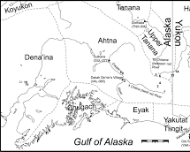
Centuries of Life: Ahtna Copper
Ahtna people have been collecting and using copper for over 500 years. It was an important source of wealth and status.
Ahtna people gathered copper nuggets from streambeds and high-grade copper ores from surface outcrops to make implements including tanged points, awls, beads, ornaments, needles, knife blades, and copper wire.
Copper was an important commodity in aboriginal trade long before European contact and was distributed over long distances via trade networks.
Notes:
https://www.jstor.org/stable/40316489?seq=5#metadata_info_tab_contents

Slide 4
1740s-1830s: First Contact with Russian Fur Traders and Enslavement of Aleut and Alutiiq (Unangan and Sugpiaq) people
Estimated population of the Unungan people at contact 15,000, reduced to 2,000 through disease and slavery (over 80% of the population) died in the 50 years following the first contact with Russian fur traders.

Slide 5
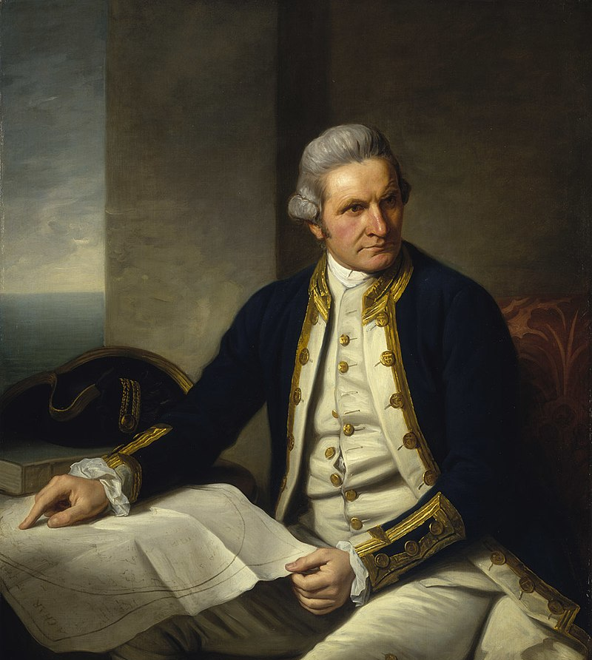
17-18th Century: European, Asian contact
17th century: Siberian Russians aware of and trading with Alaska Native people.
1728: Vitus Bering reaches Bering Strait
1778: Captain Cook is first known European in what is now Cook Inlet.
1780: Japanese whalers reach Aleutian Islands
1784: First Russian settlement, on Kodiak Island.
Official portrait of Captain James Cook. Source: Nathaniel Dance-Holland from the National Maritime Museum, United Kingdom

Slide 6
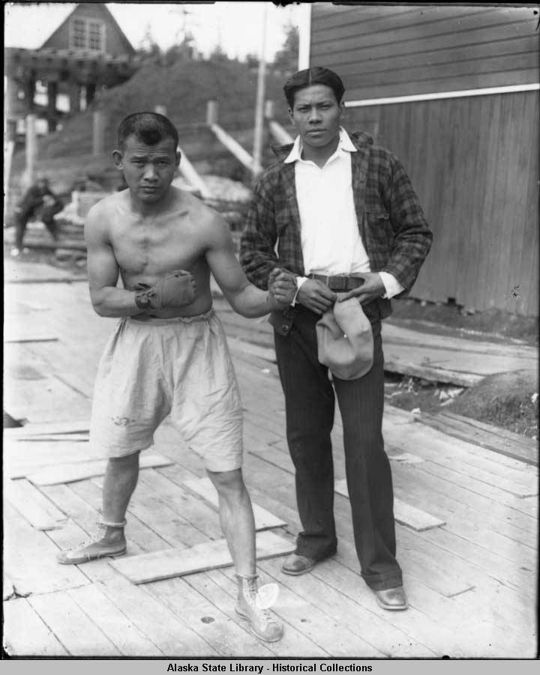
1700s-20th Century: Filipino immigration to Alaska
The ‘Manilla men’ who served on explorer’s ships in the 1700s and later crewed aboard 19th century whaling vessels.
By the 20th century, salmon canneries attracted ‘Alaskeros’ as workers.
When wages dropped during the Depression, Filipinos formed labor unions, which abolished the oppressive contract labor system.
Although significant to Alaska's economic and historical development, ‘Alaskeros’ were practically anonymous and few accounts exist that reflect their work and lives.
Two Filipino cannery workers in Yakutat, Alaska between 1913-1939. Source: Alaska State Library
Notes:
The Filipino immigration story in Alaska is deep-rooted. Historian Thelma Buchholdt documented the earliest arrivals.
2017 AKHF grant-recipient Dr. Rodill's presentation showed how Alaska canneries served as international crossroads, offering a rare glimpse into the Alaskero experience in Kodiak, and providing a female voice and Filipina perspective with the intention of strengthening Filipino identity, history and sense of place in Alaska.

Slide 7
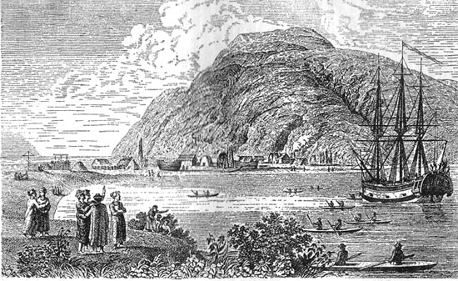
1784: Refuge Rock (Awa’uq) Massacre
Russian merchant Grigory Shelikhov, with armed mercenaries and cannons, massacres up to 3,000 Qik'rtarmiut Sugiat (Alutiiq) people on Sitkalidak Island near Kodiak.
This incident is often referred to as the Wounded Knee of Alaska.
Depiction of Grigory Shelikhov’s settlement. Source: 1802 lithograph.

Slide 8


Tara Stiller on the
Awa'uq Massacre of 1784
“That’s one of the first stories my dad told me about… It's like I could see it happening, as if I was there.”
Notes:
Tara Stiller is Alutiiq and Aleut and her family is from King Cove and Old Harbor. In this clip Tara reflects on the Awa’uq Massacre of 1784 and the legacy it has left on her people.

Slide 9
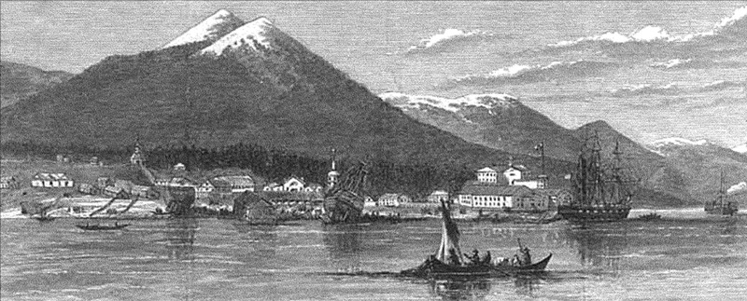
1802: Tlingit attack Russian fort at Sitka
Depiction of 1802 Tlingit attack. Source: University of Washington, Alaska and Western Canada Collection, AWC0322.
The Russian-American Company post included defensive fortifications, a warehouse to store firs, and a barracks to house the garrison.
In the Tlingit view, the Russians only owned the land the fort was on and not all the land in the area of Mikhailovsk.
In 1802, while Baranov was away, K’alyáan/Katlian, a war hero of the Kiks.ádi Tlingit, led an attack against Mikhailovsk. The Tlingits won the battle and destroyed Mikhailovsk.

Slide 10
1804: Russians and Unangan/Aleuts return to reoccupy Sitka
Aided by a Russian navy ship, Neva, and led by Baranov, Russians and Unangan/Aleuts return to reoccupy Sitka.
After two weeks of fighting what some call the Battle of Sitka, the Tlingit leave the area.
Tlingit oral accounts describe their survival march across Baranof Island.
Tlingit return to live at Sitka in 1819 at the invitation of the Russians after Baranov's departure.

Slide 11
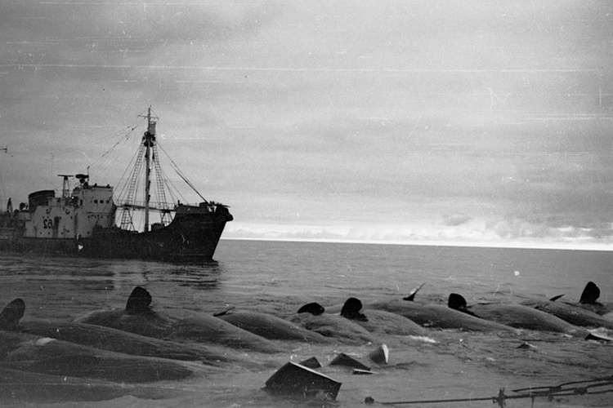
1850s-1920s: Whale population nearly destroyed and introduction of alcohol, sugar and wheat flour
A Soviet Union catcher boat with dead sperm whales. Source: Unknown; found on NOAA Fisheries website.

Slide 12

Angie Wade on
Mining & Colonialism
"Our story is just kind of waves of epidemics, and fur trade and extractive resources and miners."​
Notes:
Angie Wade is a member of Chickaloon Native Village and a resident of the Mat-Su Valley. In this clip she reflects on her family's history in the context of colonialism.

Slide 13
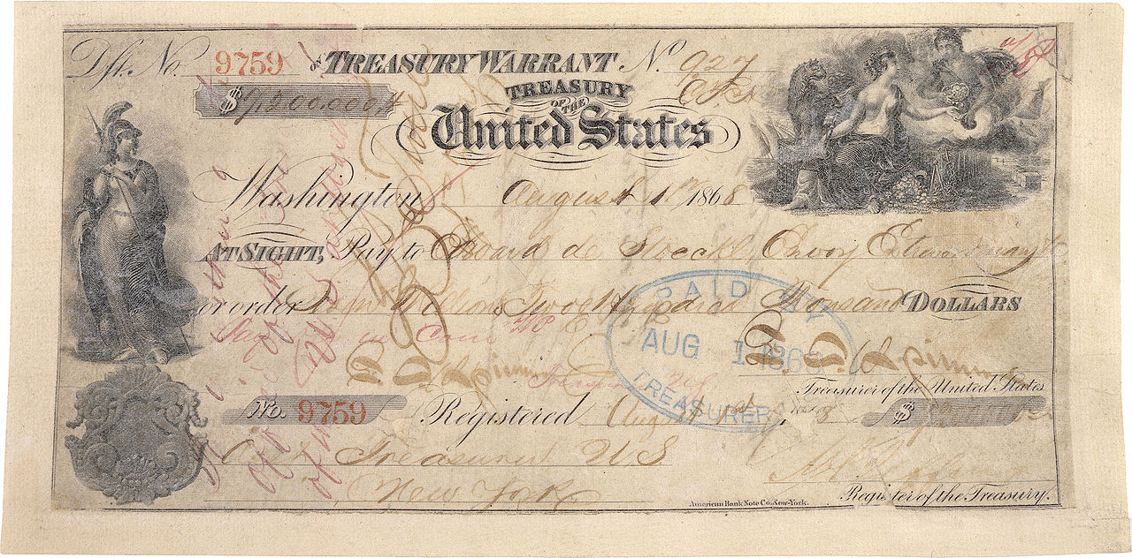
1867: US “purchase” of Alaska from Russia for $7.2 million
Picture of the US $7.2 million check used to pay for Alaska.
Alaska Native population was not consulted.
The Russians did not have ownership of the land, meaning the transaction was not a proper sale of land, only a transfer of a right to occupy.

Slide 14
1869: U.S. Military attacks Alaska Native villages
1869 Kake War: USS Saginaw bombards and burns three villages and two forts near modern-day Kake, in southeast Alaska.
1869 Wrangell Bombardment: U.S. Army bombards Stikine Tlingit village Old Wrangell for two days after residents refuse to deliver Scutd-doo, who had murdered an American merchant. Scutd-doo was retaliating for the murder of his son by American soldiers.
Scutd-doo handed over and hung, the first use of the death penalty in American Alaska.

Slide 15
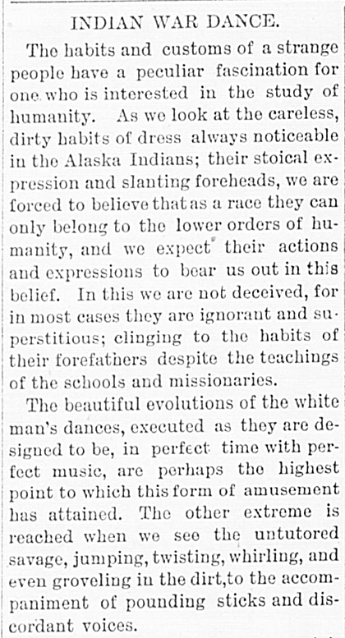
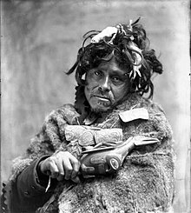
1882: Tlingit shaman; 1900: Newspaper
Douglas Island News; May 30, 1900. Source: Chronicling America: Historical American Newspapers, Library of Congress.
Portrait of Tlingit Shaman. 1900s. Source: Alaska Digital Archives.

Slide 16
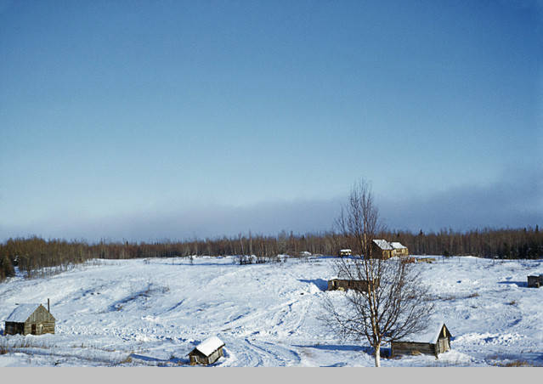
1898: Homesteading opened in Alaska
U.S. Congress opens up the 1862 Homesteading Act to include Alaska.
This special legislation spurs waves of American settlers in the coming decades.
The last homestead granted patent, in 1988, was on the Stoney River in southwestern Alaska.
Homestead in Knik, circa 1950. Source: Anchorage Museum.

Slide 17

Walter Tellman​ on the
Homestead Act​
"The people who moved in and took ownership didn't really want that story to be heard..."
Notes:
Walter Tellman is a Knik Tribe base member. In this clip he talks about how his family including his great grandfather Theodore Wasilla lost land through the Homestead Act.

Slide 18
1900s: “The Great Death”
Epidemics of smallpox, measles, chickenpox, influenza, diphtheria, and scarlet fever known collectively as “The Great Death,” decimated Alaska Native communities
    The 1918-1919 Spanish flu epidemic killed 60% of all Nome-area Alaska Native people.
    Unalaska epidemic killed one-third of the population.
Thousands of Alaska Native children were left orphans by these epidemics. Many were sent to church run orphanages like the Catholic Mission of Pilgrim Hot Springs north of Nome.

Slide 19
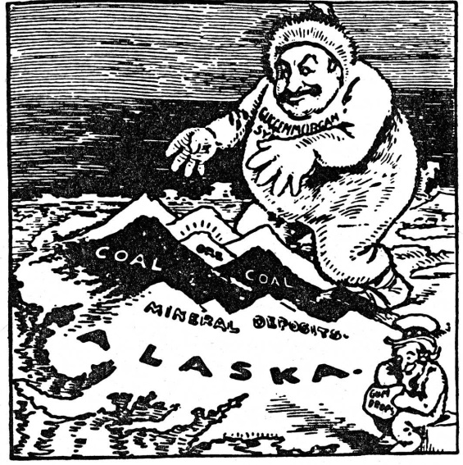
1904: Alaska Coal Act
U.S. Congress passes the Alaska Coal Act which eliminated the requirement that coal claims be on government surveyed land, leading to a land rush by settlers and corporations.
Source: Circa 1908 editorial cartoon picturing the Morgan-Guggenheim Alaska Syndicate grasping for Alaska coal reserves

Slide 20
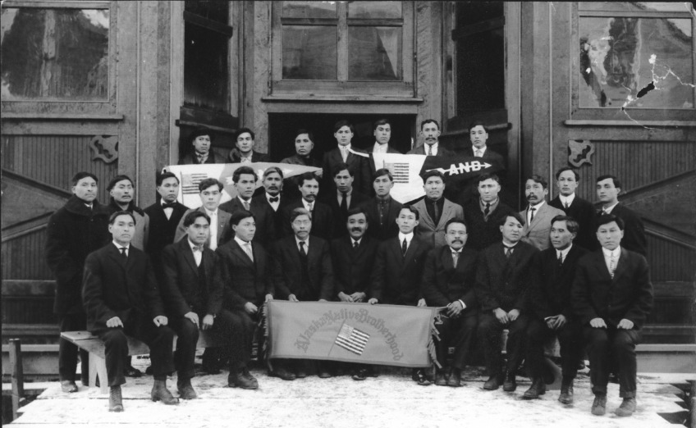
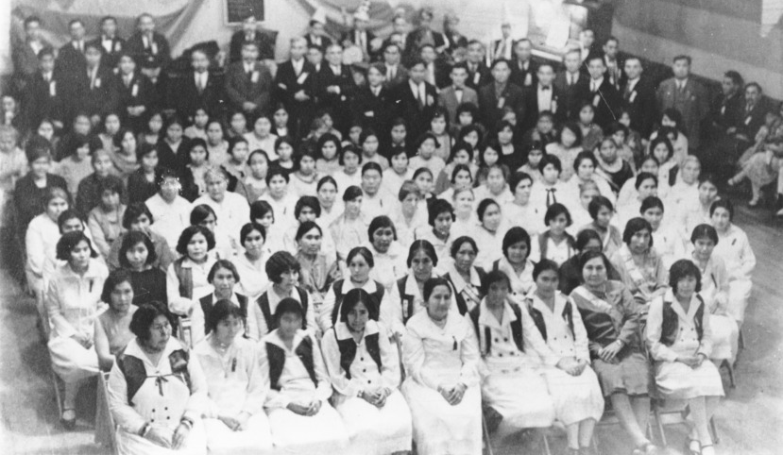
1912, 1915: Alaska Native Brotherhood/Sisterhood forms
Source: Alaska State Library Photograph Collection; 1914
Source: Alaska State Library, Alaska Native Organizations Photograph Collections, 1929
In 1912, 13 southeast Alaska Native people create the Alaska Native Brotherhood to gain recognition of Native citizenship rights, education, and abolition of “aboriginal customs”. The Alaska Native Sisterhood is established in 1915.

Slide 21
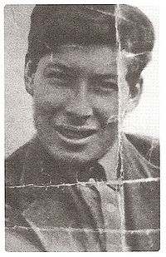
1913: First successful Denali ascent
Four men, including Walter Harper, a Koyukon Athabaskan, make the first reported ascent of Denali’s south peak, the highest point on the North American continent.
Walter Harper. Source: Original unknown, reprinted in book “Cold River Spirits” by Jan Harper-Haines

Slide 22
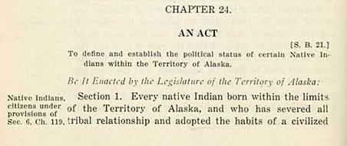
1915: Alaska Native citizenship
The Territorial Legislature passes a law allowing Alaska Native people to become Alaska citizens.
However, to become a citizen, Alaska Natives had to obtain endorsements from five white citizens and have “severed all tribal relationships and adapted the habits of a civilized life”.
An act to define the political status of certain Natives within the Territory of Alaska, April 1915; Source: Alaska Humanities Forum

Slide 23
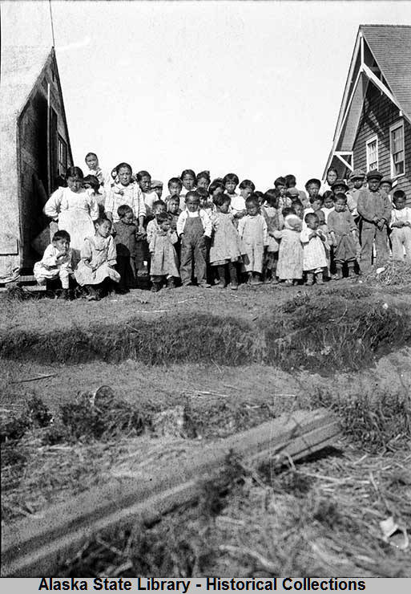
1918-1919: Spanish Flu Epidemic
In Alaska, the Spanish Influenza epidemic of 1918 to 1919 was primarily restricted to coastal communities such as Nome, Anchorage, Skagway, and Seward. Many interior communities like Fairbanks had no significant outbreaks or deaths.
The exception was the Matanuska-Susitna Valley, where Alaska Railroad construction pressed forward even as surrounding towns such as Anchorage were quarantined.
As a result, many of the area Dena’ina and Ahtna communities were depopulated.
Alaska Native children of 1919 flu victims. Source: Alaska Digital Archives

Slide 24

Rain Wade on the
Boarding School Era
“My mother was born in 1922 and she was not sent away to boarding school but all of her brothers and sisters were.”
Notes:
Rain Wade is a member of the Chickaloon Native Village and a resident of the Mat-Su Valley. In this clip she reflects on the boarding school era and how it impacted her mother and her mother's siblings.

Slide 25
1922: Alaska Native Right to Vote
After Charlie Jones, Tlingit, is arrested in Wrangell for voting, and Tillie Paul Tamaree is arrested for aiding and abetting him, a federal court gives Alaska Native people the right to vote in territorial elections, two years before all Native Americans get the right to vote in public elections. Jones is acquitted and the charges against Tamaree are dropped.
In 1924, U.S. Congress passes the Indian Citizenship Act recognizing Native Americans and Alaska Natives as US citizens.

Slide 26
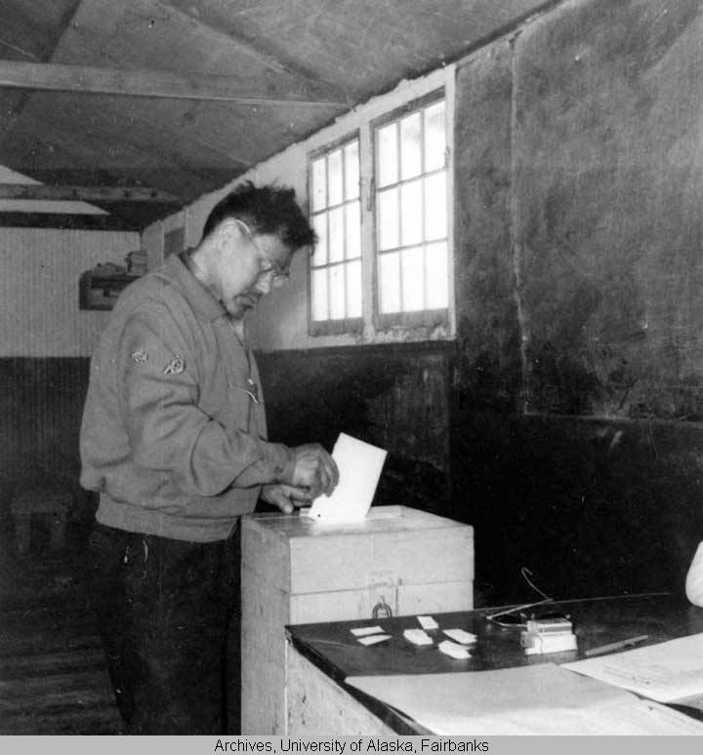
1925: The Territorial Legislature passes a literacy act
Because of the expansion of Alaska Native voting rights and the rising political power of Tlingit William Paul, the Alaska Territorial Legislature passed a literacy act requiring a person to read and write English to vote in territorial elections.
Alaska had an English literacy requirement to vote through 1970.
Source: University of Alaska Fairbanks .

Slide 27
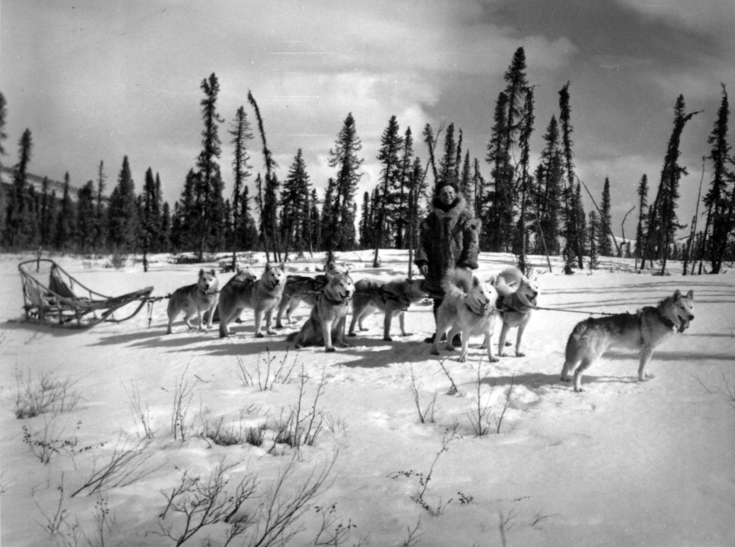
1925: Dog teams and drivers relay serum from Nenana to Nome
Dog teams and drivers, most of whom are Alaska Native, relay diphtheria serum from Nenana to Nome to prevent an epidemic.
The event receives national media attention though Alaska Native drivers are ignored in favor of whites (e.g., Leonhard Seppala, Gunnar Kaasen).
Source: Robert Fortuine papers, Archives and Special Collections, Consortium Library, University of Alaska Anchorage

Slide 28
1935: Establishment of Matanuska Colony, modern day Palmer
Without consultation with Alaska Native people, the federal government established a colony of Minnesota farmers in what is now Palmer, the Matanuska Colony.

Slide 29
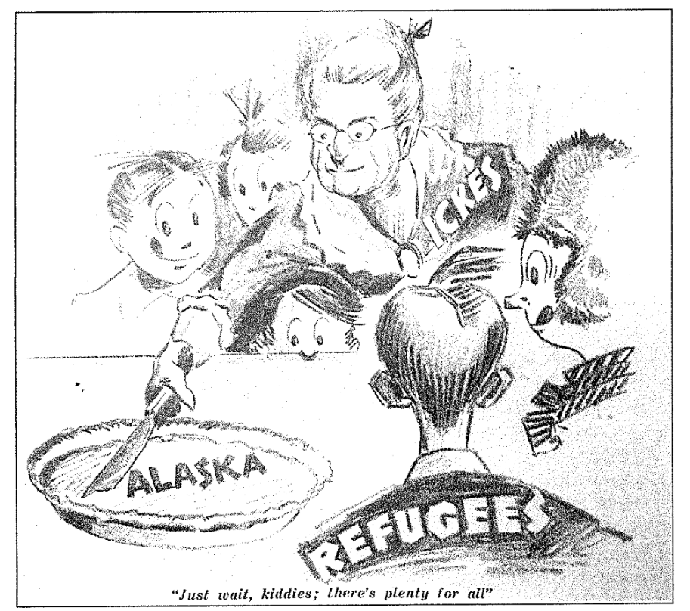
1940s: Denial of resettlement plan for Jewish Holocaust Refugees in Alaska
In 1939, the Department of the Interior proposed Jewish refugees should settle in Alaska. Alaskans near uniformly rejected Jews as suitable settlers.
A 1940 Alaska Life magazine poll found 88.5% of Alaskans opposed to foreign settlement in Alaska.
In 1941, Ernest Patty, later president of the University of Alaska, said, referring to Jewish people, “America should borrow a page from the Germans and attempt to do some long-range planning for the future.”
Source: Alaska Life, October 1940.

Slide 30
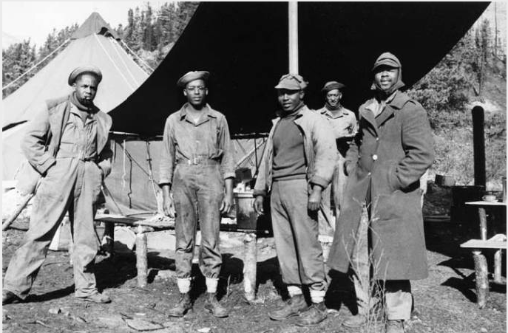
1940s: Construction of Alcan Highway
During World War II, Black Army regiments played a vital role in constructing the Alaska-Canadian (Alcan) Highway.
The 10,000 US soldiers who built the Alaska Highway included about 3,500 African-American troops.
Many Alaska Native people relocated to look for work on the new highway. The move separates families and interferes with traditional lifeways.
US soldiers who built the Alaska Highway. Source: US Army/University of Alaska archives
Videos around the experiences of constructing the Alaska Highway: https://alaskahighwayproject.blogspot.com/p/videos.html

Slide 31
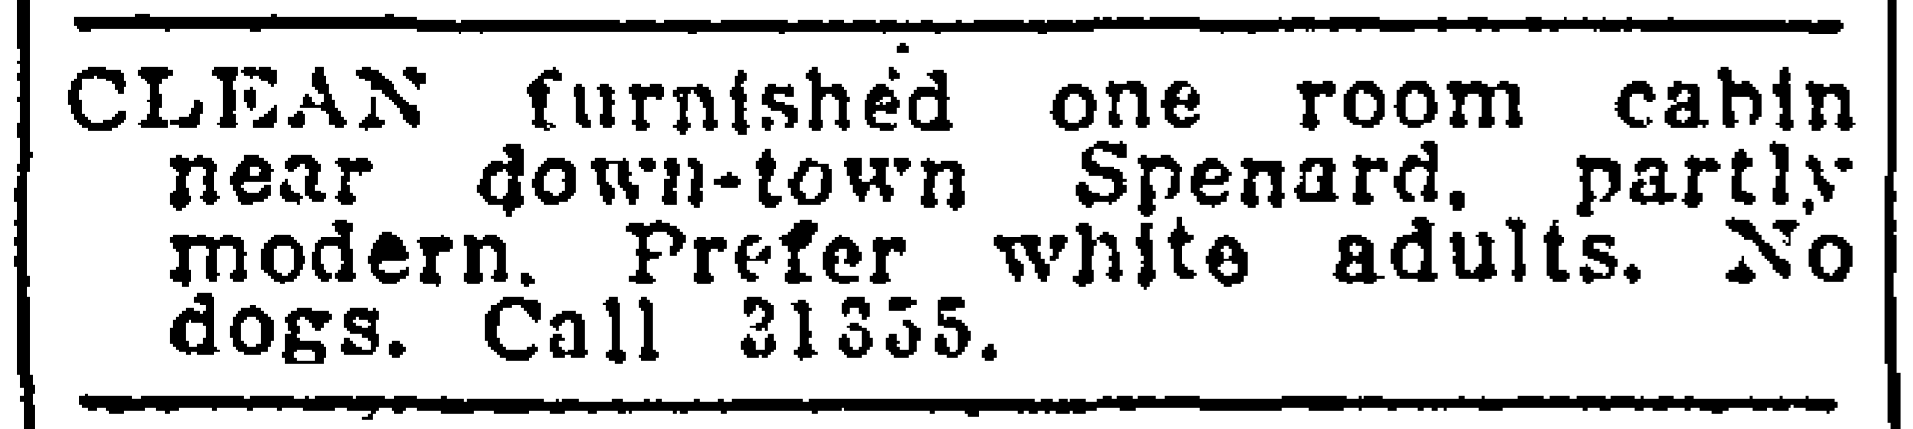
1945: Alaska Anti-Discrimination Act
Elizabeth Peratrovich petitions Alaska legislature to end Jim Crow practices in Alaska, and the Alaska Anti-Discrimination Act passes in 1945, nearly 20 years before the passage of federal civil rights act of 1964.
This new policy ended the common signs in store and restaurant windows that read “No Dogs, No Natives.”
Source: Anchorage Daily Times, November 1952.

Slide 32
1940s-1950s: Housing discrimination
As Alaska’s population boomed in the 1940s and 1950s, housing discrimination became explicit, primarily in the more urban centers of Anchorage and Fairbanks. This explicit discrimination included racially restrictive housing covenants in deeds and subdivisions plats, and exclusionary housing classifieds.
In Anchorage, African Americans were largely restricted to an area known as Eastchester Flats, later cleared by urban renewal in the late 1960s.
Racially restrictive covenants remain visible in deeds today.

Slide 33
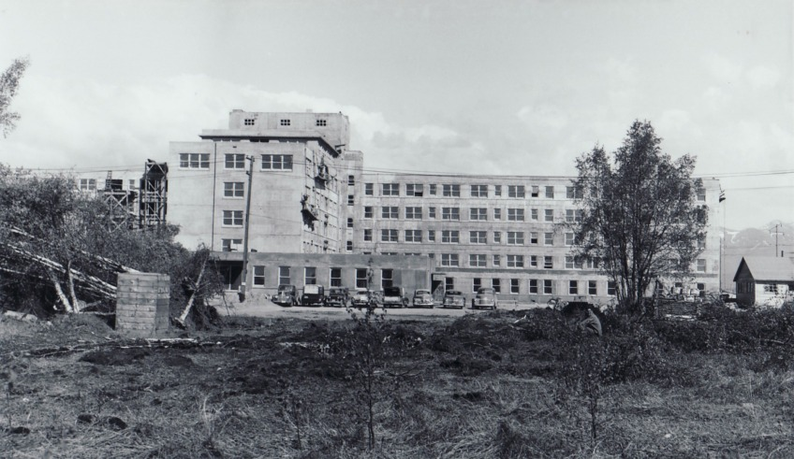
1953: Alaska Native Service hospital
The Alaska Native Service, part of the Bureau of Indian Affairs, opens a 400-bed hospital with a dedicated tuberculosis wing in Anchorage.
In the early 1950s, the statewide death rate for Alaska Natives is 653 per 100,000 cases.
Source: Indian Health Service/US Department of Health and Human Services

Slide 34
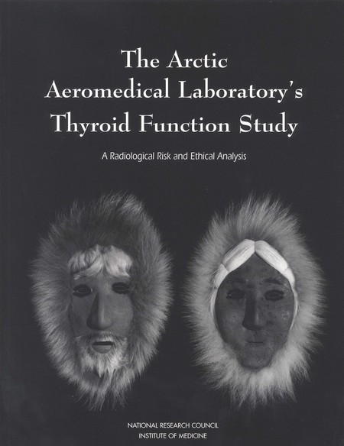
1956-1957: Air Force Iodine-131 study
From 1956 to 1957, the U.S. Air Force’s Arctic Aeromedical Laboratory conducted a study on the role of the thyroid in acclimating to cold weather. 102 Northwest Alaskan Iñupiat people were given radioactive iodine as part of the experiment.
In 2000, the U.S. government appropriated compensation of $67,000 per participant.
Many of the participants developed severe thyroid problems and died of cancer.

Slide 35
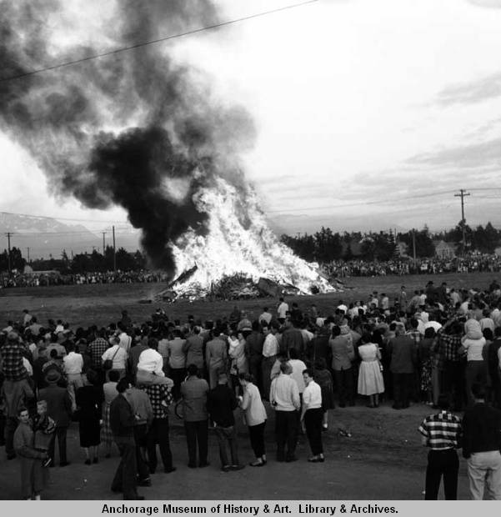
1959: Alaska becomes the 49th state
Alaska becomes the 49th state.
The State starts selecting land as provided for under the Act. Alaska Native population was not consulted or adequately represented in Constitutional Convention.
Alaska Native people routinely object to the selections to call attention to their land claims.
Bonfire to celebrate statehood, Anchorage, June 30, 1958.
Source: Anchorage Museum

Slide 36
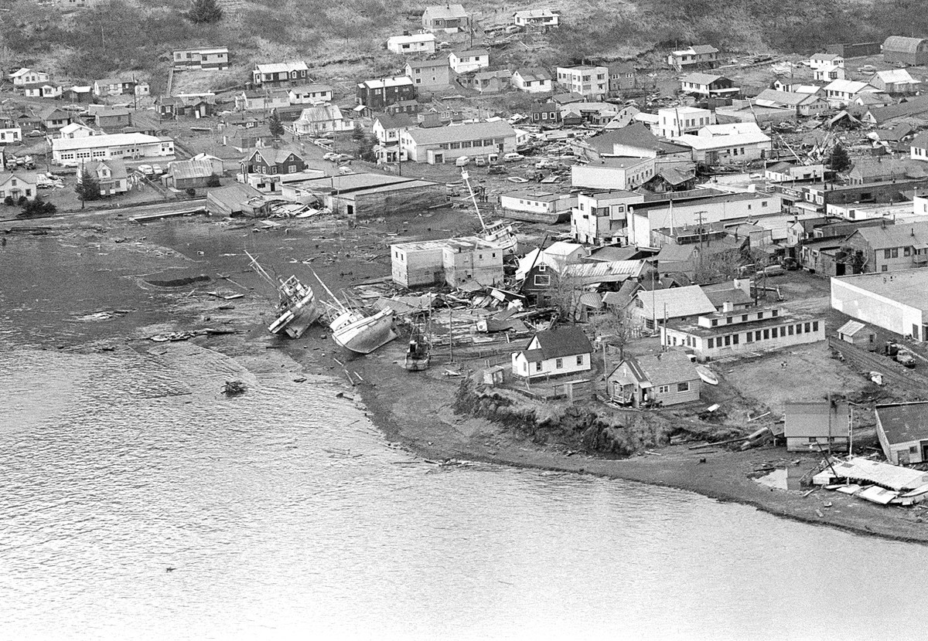
1964: Great Alaska Earthquake
On March 27, 1964 at 5:36 PM, the great Alaska earthquake occurred measuring 9.2 on the Richter scale which set off tidal waves. The quake alone lasted for four minutes and 18 seconds.
The earthquake devastated Southcentral Alaska, leaving 139 dead and destroying a number of communities, among them the Native villages of Chenega, Old Harbor and Kaguyak, forcing residents to relocate. The resulting tsunami reached heights of 67 meters in some places. This was the second strongest earthquake in recorded history.
Kodiak tsunami destruction; Source: Associated Press

Slide 37
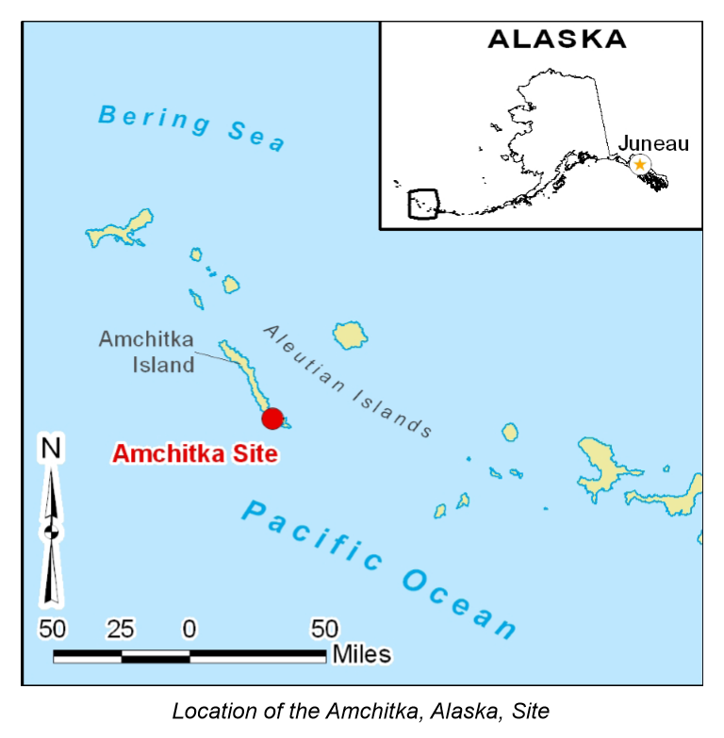
1965-1971: Amchitka Island nuclear tests
Amchitka was an ancestral home for the Aleut people from roughly 4,000 years ago through Russian contact.
In 1965, 1969, and 1971, the U.S. Department of Defense conducted underground nuclear detonation testing.
Source: U.S. Department of Energy

Slide 38

1966: Alaska Federation of Natives formed
The Alaska Federation of Natives (AFN) forms and holds first statewide meeting with over 400 Alaska Native leaders in attendance.
The focus of the first meeting was land claims. Secretary of the Interior Stewart Udall imposed a freeze on all land actions in Alaska by the federal government until Native land claims are resolved.

Slide 39
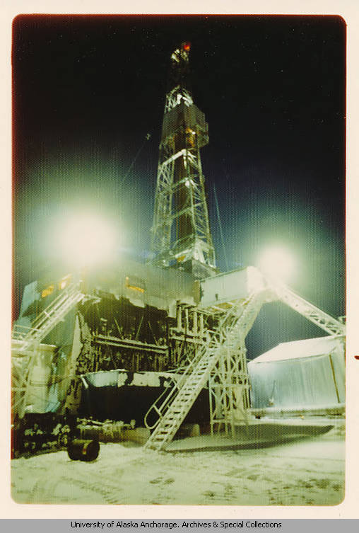
1968: North Slope oil fields confirmed
For years, geologists believed there were oil fields along Alaska’s North Slope. But in March 1968, oil companies confirmed the existence of the Prudhoe Bay Oil Field, with twice as much recoverable oil as any other American oil field.
Prudhoe Bay oil well, circa 1980.
Source: University of Alaska Anchorage

Slide 40
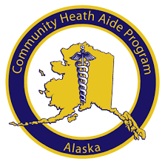
1968: Community Health Aide Program
The State of Alaska initiates the Community Health Aide Program to improve emergency medical care in rural Alaska.

Slide 41
1970: Literacy requirement for voting repealed
Alaskan legislators included an English literacy requirement for voting in the original Alaska Constitution.
The statute was narrowly repealed by a popular vote in August 1970, 45 years after the first such requirement was enacted in Alaska.
Source: Anchorage Daily Times, August 24, 1970

Slide 42
1971: Alaska Native Claims Settlement Act (ANCSA)
This act resulted in loss of aboriginal title to land, aboriginal rights to hunting and fishing, and the loss of resources and lands, into the hands of the state of Alaska.
This act cleared the way for the trans-Alaska pipeline, and allowed the state of Alaska to claim 104 million acres of land selections.
Alaska Natives received fee simple title to 44 million acres, which excluded the 44 million acres from being considered “Indian Country.”
Although Alaska Natives are the largest private landowners in the US, the fee simple title held by Alaska Natives prevents the majority of that land to be litigated under principles of Federal Indian Law, to the disadvantage of Alaska Native People. Only one federal Indian reservation with the ability to be called “Indian Country” exists in Alaska – the Metlakatla Indian Community of the Annette Island Reserve in southeastern Alaska.
Notes:
A century after acquiring Alaska from Russia, the U.S. moves to extinguish the claim of many hundred Alaska Native communities to their aboriginal lands. The Alaska Native Claims Settlement Act revokes all but one of the reserves and reservations in the state. In return, Alaska Natives are granted one-ninth of the state or 40 million acres to be divided among them along with a shared payment of $462,500,000. The act establishes Alaska Native corporations, including 13 regional corporations and many more local village corporations, that receive shares of the payment and begin developing local economies to benefit Alaska Native people.

Slide 43
1972-1976: Tobeluk v. Lind lawsuit
Alaska Legal Services files class-action lawsuit, a.k.a. the Molly Hootch case, on behalf of rural children and fights for each Alaskan community to have public high schools.
Previous to 1966, most hub community schools were segregated. Before 1975, if a rural child wanted to seek education past eighth grade, the student had to leave the home community for boarding schools specifically set up for Alaska Native students. Boarding school students were often physically, mentally, emotionally, and sexually abused by teachers and administrators. Boarding school students typically lost much of their cultural identity.
With the October 1975 Tobeluk Consent Decree, the State of Alaska committed to provide high school education for rural students. 105 new high schools would open across the state.

Slide 44
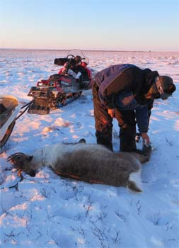
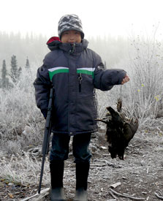
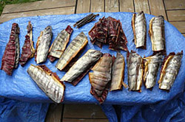
1978: Alaska Subsistence Law
Source: Alaska Department of Fish and Game
'Always give your first catch to an Elder. Respect the land and the animals. Harvest only what you need and be sure to take care of what you harvest.’
- Denali Whitting, Kotzebue, Alaska
When we speak of ‘subsistence,’ we don’t just mean using the resource, but using tribal methods and acting out culture and complying with those values, and we do those things because they are a measure of protection for the land and its resources.
– A Venetie hunter

Slide 45
1992: Alaska Native Representation
Georgianna Lincoln from Rampart is the first Alaska Native woman elected to the Alaska Senate.
She is the only Alaska Native woman ever elected to the Alaska State Senate.
Source: Doyon, Limited

Slide 46
1997-1999: Alaska Native people take charge of health clinics, hospital
Alaska Native Tribal Health Consortium (ANTHC), the largest tribal-run health organization in the US, manages the statewide medical and public health services of the Alaska Native Tribal Health system. It oversees specialty medical care, construction of water and sanitation and health facilities, community health and research, and information technology. ANTHC provides health services to about 150,000 Alaska Natives and American Indians in Alaska.
ANTHC is owned and managed by Alaska Native tribal governments and their regional health organizations. In 1997, a new Alaska Native Medical Center replaced the one built in the 1950s in Anchorage.
In 1999, Southcentral Foundation and ANTHC take over management of all Indian Health Service programs at the Alaska Native Medical Center and other Alaska Native health facilities statewide.

Slide 47
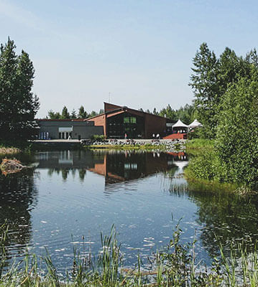
1999: Alaska Native Heritage Center opens in Anchorage
Established in 1999, the Alaska Native Heritage Center, per its mission statement, “preserves and strengthens the traditions, languages, and art of Alaska’s Native People through statewide collaboration, celebration, and education.”
Source: Alaska Native Heritage Center

Slide 48
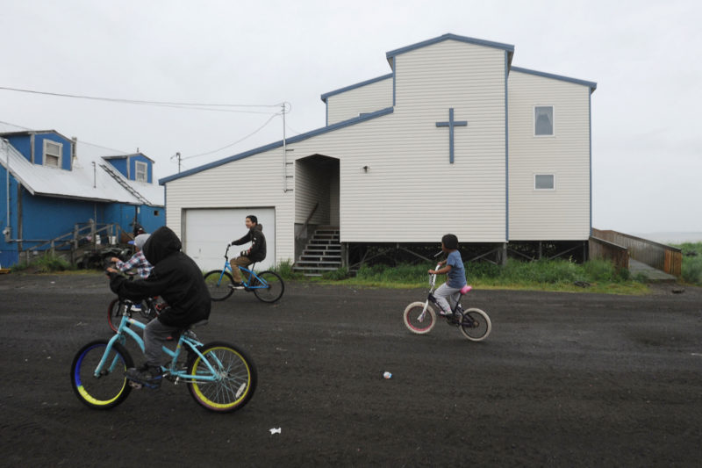
2011: Extent of sexual abuse by Catholic officials in Alaska highlighted
The devastating experiences of the Catholic Church sexual abuse of children and women in rural Alaska is shared through the PBS frontline film entitled “The Silence.”
Decades of abusive Alaska Natives by priest and church workers have left generations in affected communities with posttraumatic stress disorder.
The Catholic church in the village of Stebbins on Norton Sound in Western Alaska. Source: Bill Roth/Anchorage Daily News

Slide 49
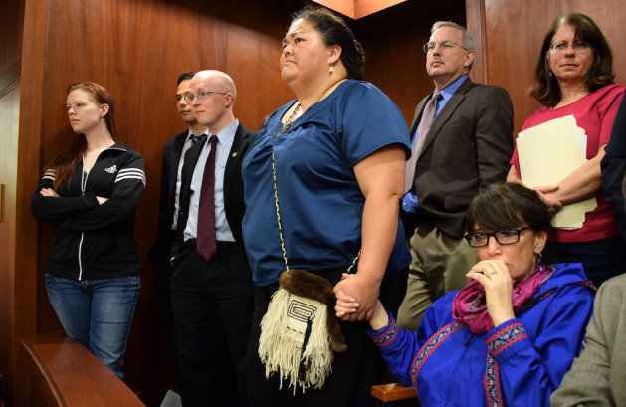
2014: Alaska legislature officially recognizes 20 Alaska Native languages
"An Act adding the Inupiaq, Siberian Yupik, Central Alaskan Yup'ik, Alutiiq, Unanga, Dena'ina, Deg Xinag, Holikachuk, Koyukon, Upper Kuskokwim, Gwich'in, Tanana, Upper Tanana, Tanacross, Hän, Ahtna, Eyak, Tlingit, Haida, and Tsimshian languages as official languages of the state."
Source: Skip Gray/Gavel Alaska/KTOO

Slide 50

2016: Presbyterian Church apology
At the 2016 Alaska Federation of native convention, leaders of the Presbyterian Church apologized for their role in Alaska Native boarding schools, including the forced removal of Alaska Native children and destruction of Native culture.
“You did nothing wrong. You were and are the victims of evil acts that cannot under any circumstances be justified or excused.” –Curt Karns, executive priest for Presbyterian Church’s Yukon Region
Curt Karns of the Presbyterian Church speaks at AFN, 2016.
Source: Anchorage Daily News.

Slide 51
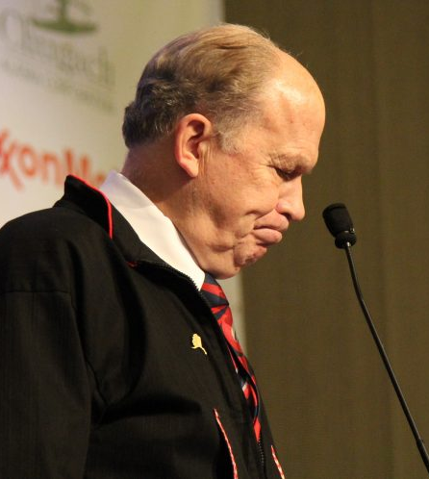
2018: Governor Bill Walker apology
Alaska Gov. Bill Walker apologized at the annual Alaska Federation of Natives in Anchorage for historical wrongs.
“As the 11th governor of the state of Alaska, I apologize to you, Alaska's first people, for the wrongs that you have endured for generations. For being forced into boarding schools, I apologize. For (being) forced to abandon your Native language and adopt a foreign one, I apologize. For erasing your history, I apologize. For the generational and historic trauma you have suffered, I apologize.”
Source: Photo by Zachariah Hughes, Alaska Public Media – Anchorage

Slide 52
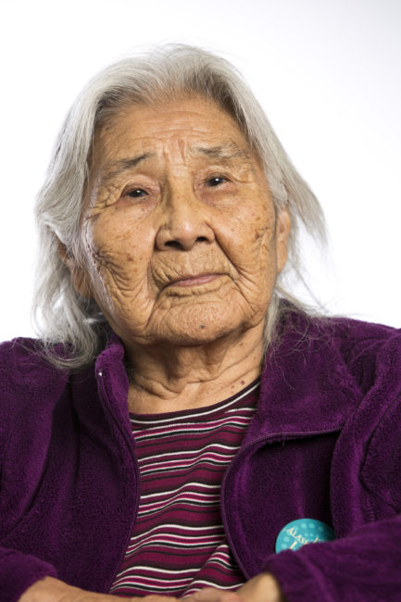
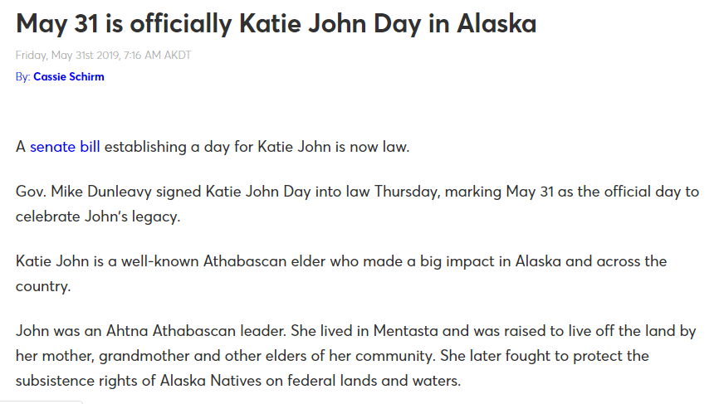
2019: Katie John Day
Source: KTVA.com; May 31, 2019
Photo by Chris Arend. Photo owned by Ahtna, Incorporated.

Slide 53
2020: No Funding for Alaska Marine Highway System
“From the tribes’ perspective, enough is enough… our communities are the most affected. This marine highway is the lifeblood of Alaska… for people to flippantly say, ‘Well you choose to live in rural Alaska.’ Yeah, I choose to live where my ancestors have lived for 10,000 years. Absolutely, damn straight.”
Richard Chalyee Éesh Peterson, President of the Central Council of Tlingit and Haida Indian Tribes
Notes:
Several Mat-Su legislators claimed that people “choose” to live in rural Alaska.

