Slide 1
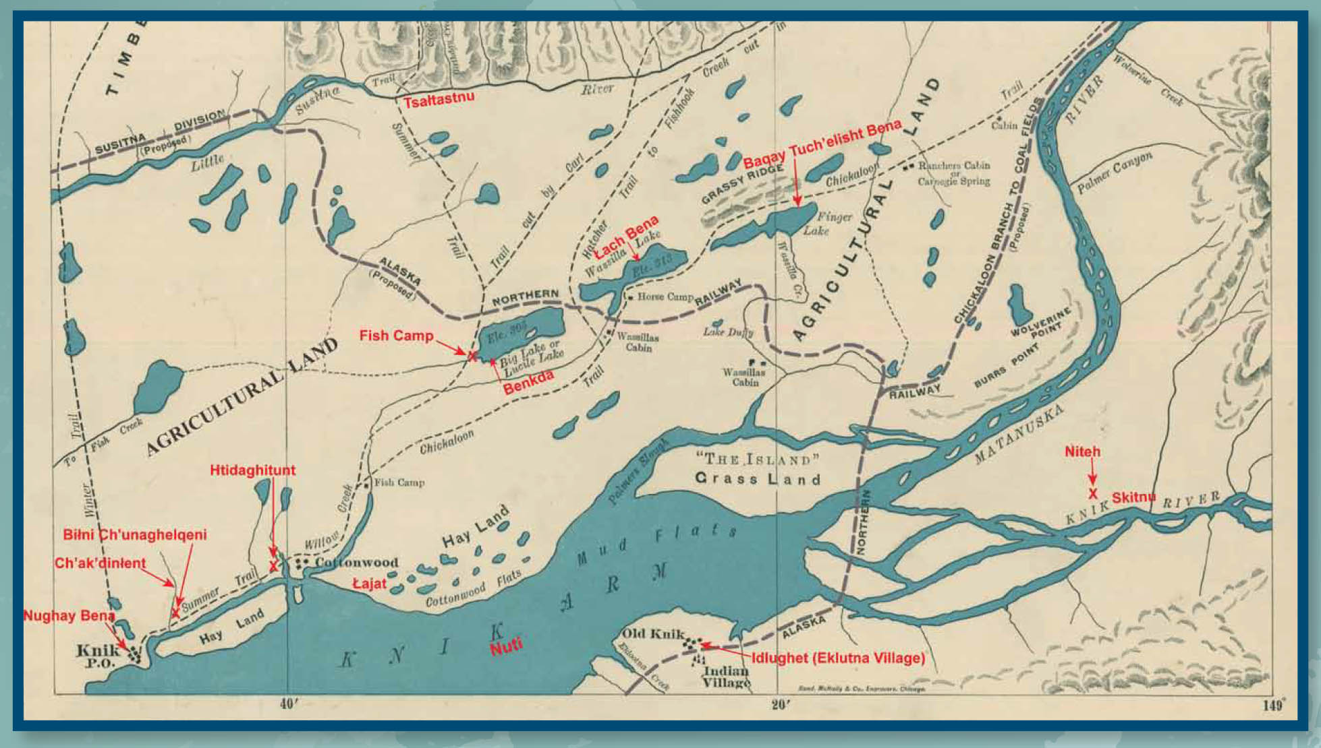
Chickaloon/knik/Mat-Su Selected historical events – See the unseen

Slide 2
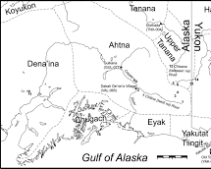
Centuries of Life: Ahtna Copper
Ahtna people have been collecting and using copper for over 500 years. It was an important source of wealth and status.
Ahtna people gathered copper nuggets from streambeds and high-grade copper ores from surface outcrops to make implements including tanged points, awls, beads, ornaments, needles, knife blades, and copper wire.
Copper was an important commodity in aboriginal trade long before European contact and was distributed over long distances via trade networks.
Notes:
https://www.jstor.org/stable/40316489?seq=5#metadata_info_tab_contents

Slide 3
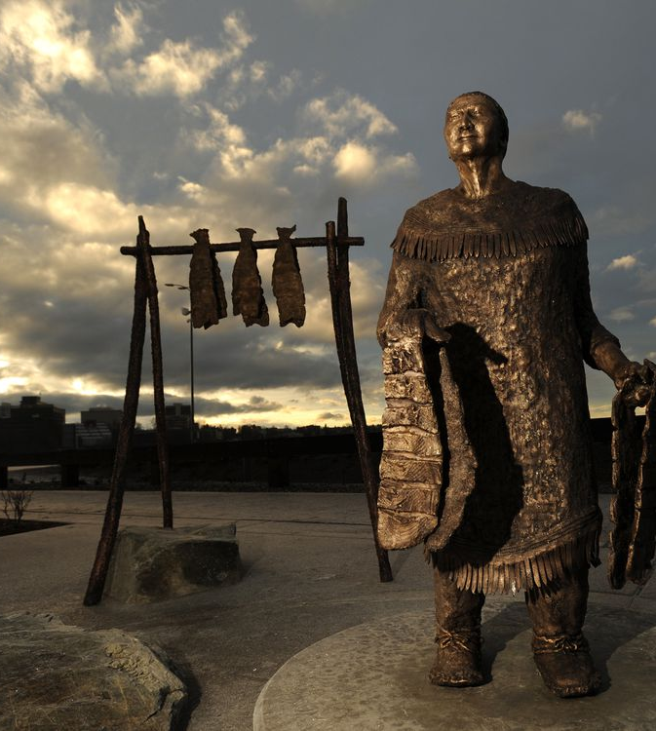
Centuries of Life: Dena’ina of Tikatnu
For centuries, the Dena’ina people, were self-sufficient and living in communal hunter-gather villages along the rivers and shores of Tikatnu, now called Cook Inlet.

Slide 4
1794: Russians and Dena’ina Women
Russian settlers in Alaska frequently abducted Dena’ina women.
In 1794, the British explorer George Vancouver identified 23 buildings at Fort Nikolaevskaia (modern day Kenai) as “the residence of such of the natives as were the companions, or the immediate attendants of the Russians.”
“A long time ago some Russians came up the river. They stole some women and raped them. We couldn’t fight them, they had guns. So we decided what to do. The men waited until nighttime, and after they had gone to sleep, they attacked and killed every last one of them.”
Katherine Wade, recounted by Rain Wade

Slide 5
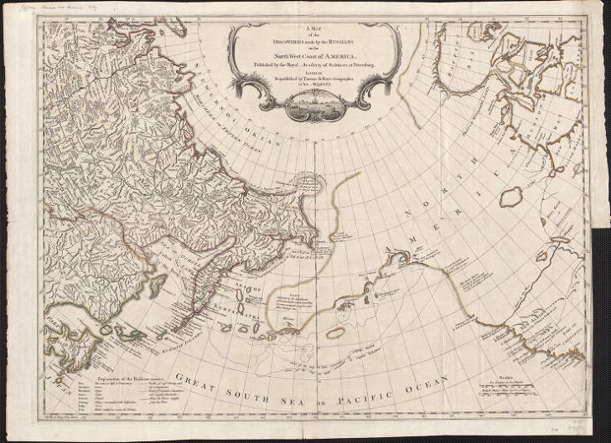
1834-1860: Russian Exploration of Mat-Su
1834: Vassili Malakoff travels up the Susitna River for the Russian-American Company, seeking exploitable resources, navigable passages, and possible settlement sites. This marked the beginning of colonial intrusion into the Mat-Su region.
1860: By this time, Russian maps show the courses of the Matanuska and Susitna Rivers.
Map of Russian exploration on the north west coast of America, 1760-1769, English copy of Russian original, University of Alaska Fairbanks

Slide 6
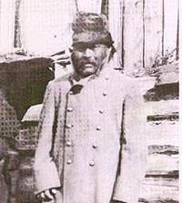
Mid-1800s: Chief Visilla
Visilla, the Qesh’qa or Bente’en, Chief of Benteh (among the lakes), brokered peace with the Copper River Ahtna;
Wrote in Cyrillic, he provided for his people and was well-known as a healer and shaman.
Wasilla is named after him.

Slide 7
Mid-1800s to present: Sexual Assault by Settlers
Beginning with the arrival of Russian explorers in the mid-19th century, Alaska Native women in the Mat-Su have been preyed upon by colonial explorers and settlers.
Alaska is the most dangerous state for women. Per 2017 data, only 13% of Alaskan sexual assault cases result in an arrest.
Rates for sexual assault and domestic violence against Alaska Native women is up to 10 times the national rate.
“I think they wanted to sexually assault us just because we were little Natives.”
“The Palmer kids start treating them that way, too. Just because they’re Natives they think they just take you out and have sex with you.”
Katherine Wickersham Wade speaking on her experiences in the 1930s, Chickaloon Spirit

Slide 8
Perceptions of Ownership
The Russian and American intrusions into the Mat-Su region impacted Alaska Native relationships with nature, especially the land. What had been loosely bounded zones of influence and responsibility were forced to change because of colonial understandings of land ownership.
“I think one of the things we lost was our equal relationship with the animals and nature. With the fur trade, we developed a ‘power over’ relationship with animals/nature and that began eroding our spirituality and our ethic of reciprocity.”
Rain Wade, recounted by Angie Wade

Slide 9
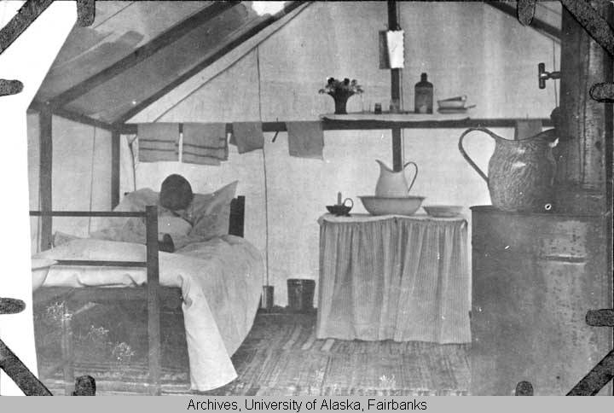
1836-1840: Great Plains Smallpox Epidemic
Roughly 1836 to 1840, what is elsewhere known as the Great Plains smallpox epidemic reaches southcentral Alaska and rages through the Mat-Su Valley.
The epidemic reaching the Mat-Su Valley was directly after contact with colonial explorers.
Smallpox patient at St. John’s Mission, interior Alaska, c. 1900, University of Alaska Fairbanks

Slide 10
Angie Wade on Mining & Colonialism
"Our story is just kind of waves of epidemics, and fur trade and extractive resources and miners."​
Notes:
Angie Wade is a member of Chickaloon Native Village and a resident of the Mat-Su Valley. In this clip she reflects on her family's history in the context of colonialism.

Slide 11
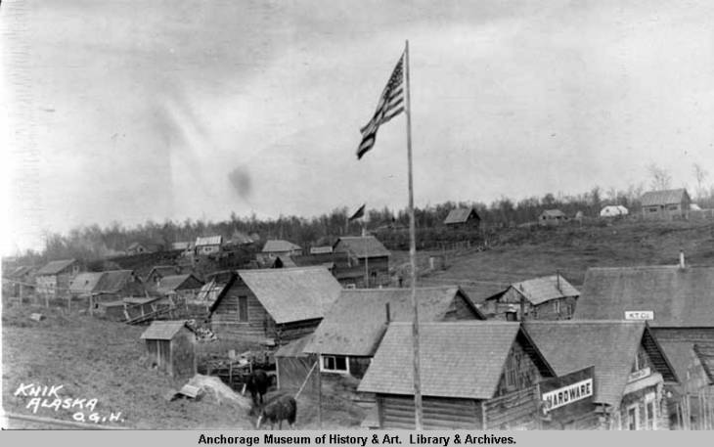
1894-1906: Non-Native Resource Extraction
1894: Coal discovered in Chickaloon area
1891: Gold discovered along Turnagain Arm
1896: Cook Inlet Gold Rush
1898: U.S. Army expedition blazes trail through Matanuska Valley
1906: Gold discovered in upper Susitna River region
1906: Coal mining begins in Chickaloon
Knik circa 1914, an early 20th century Alaska boomtown, Anchorage Museum

Slide 12
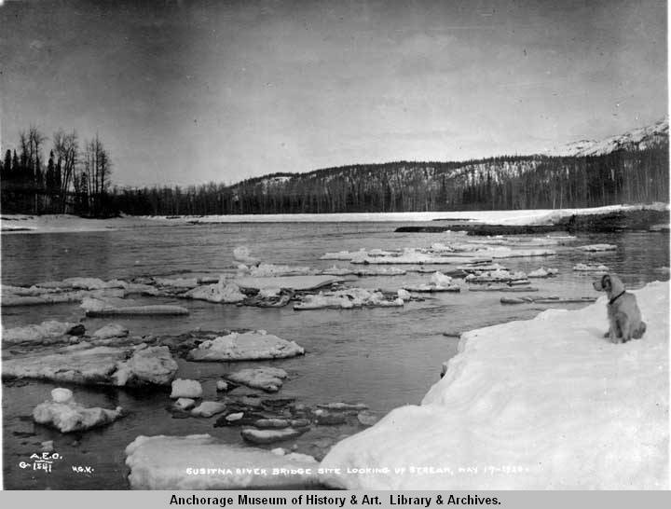
Predicted Fate of Mat-Su Dena’ina
“Susitna will disappear. It will disappear. Only grass will grow there. That grass will cover the whole village. The Tanainas of Susitna will disappear . . . There will be only Americans.”
Shem Pete, recounting his uncle’s prediction for the fate of the Dena’ina, Susitnu Htsukdu’a, 1975
Susitna River, Susitna Bridge site, 1920, Anchorage Museum

Slide 13
1914: Alaska Railroad Act
1914: Without consultation with Alaska Native people, U.S. Congress passes the Alaska Railroad Act, “so as best to aid in the development of the agricultural and mineral or other resources of Alaska, and the settlement of the public lands therein.” This sets the stage for the next twenty years of resource exploitation and settler/Alaska Native interactions.
President Woodrow Wilson authorizes the Alaska Engineering Commission (AEC) to oversee construction and operation of a railroad in Alaska connecting coal fields to warm water ports.
1915: AEC establishes the town of Anchorage as its primary command base.

Slide 14
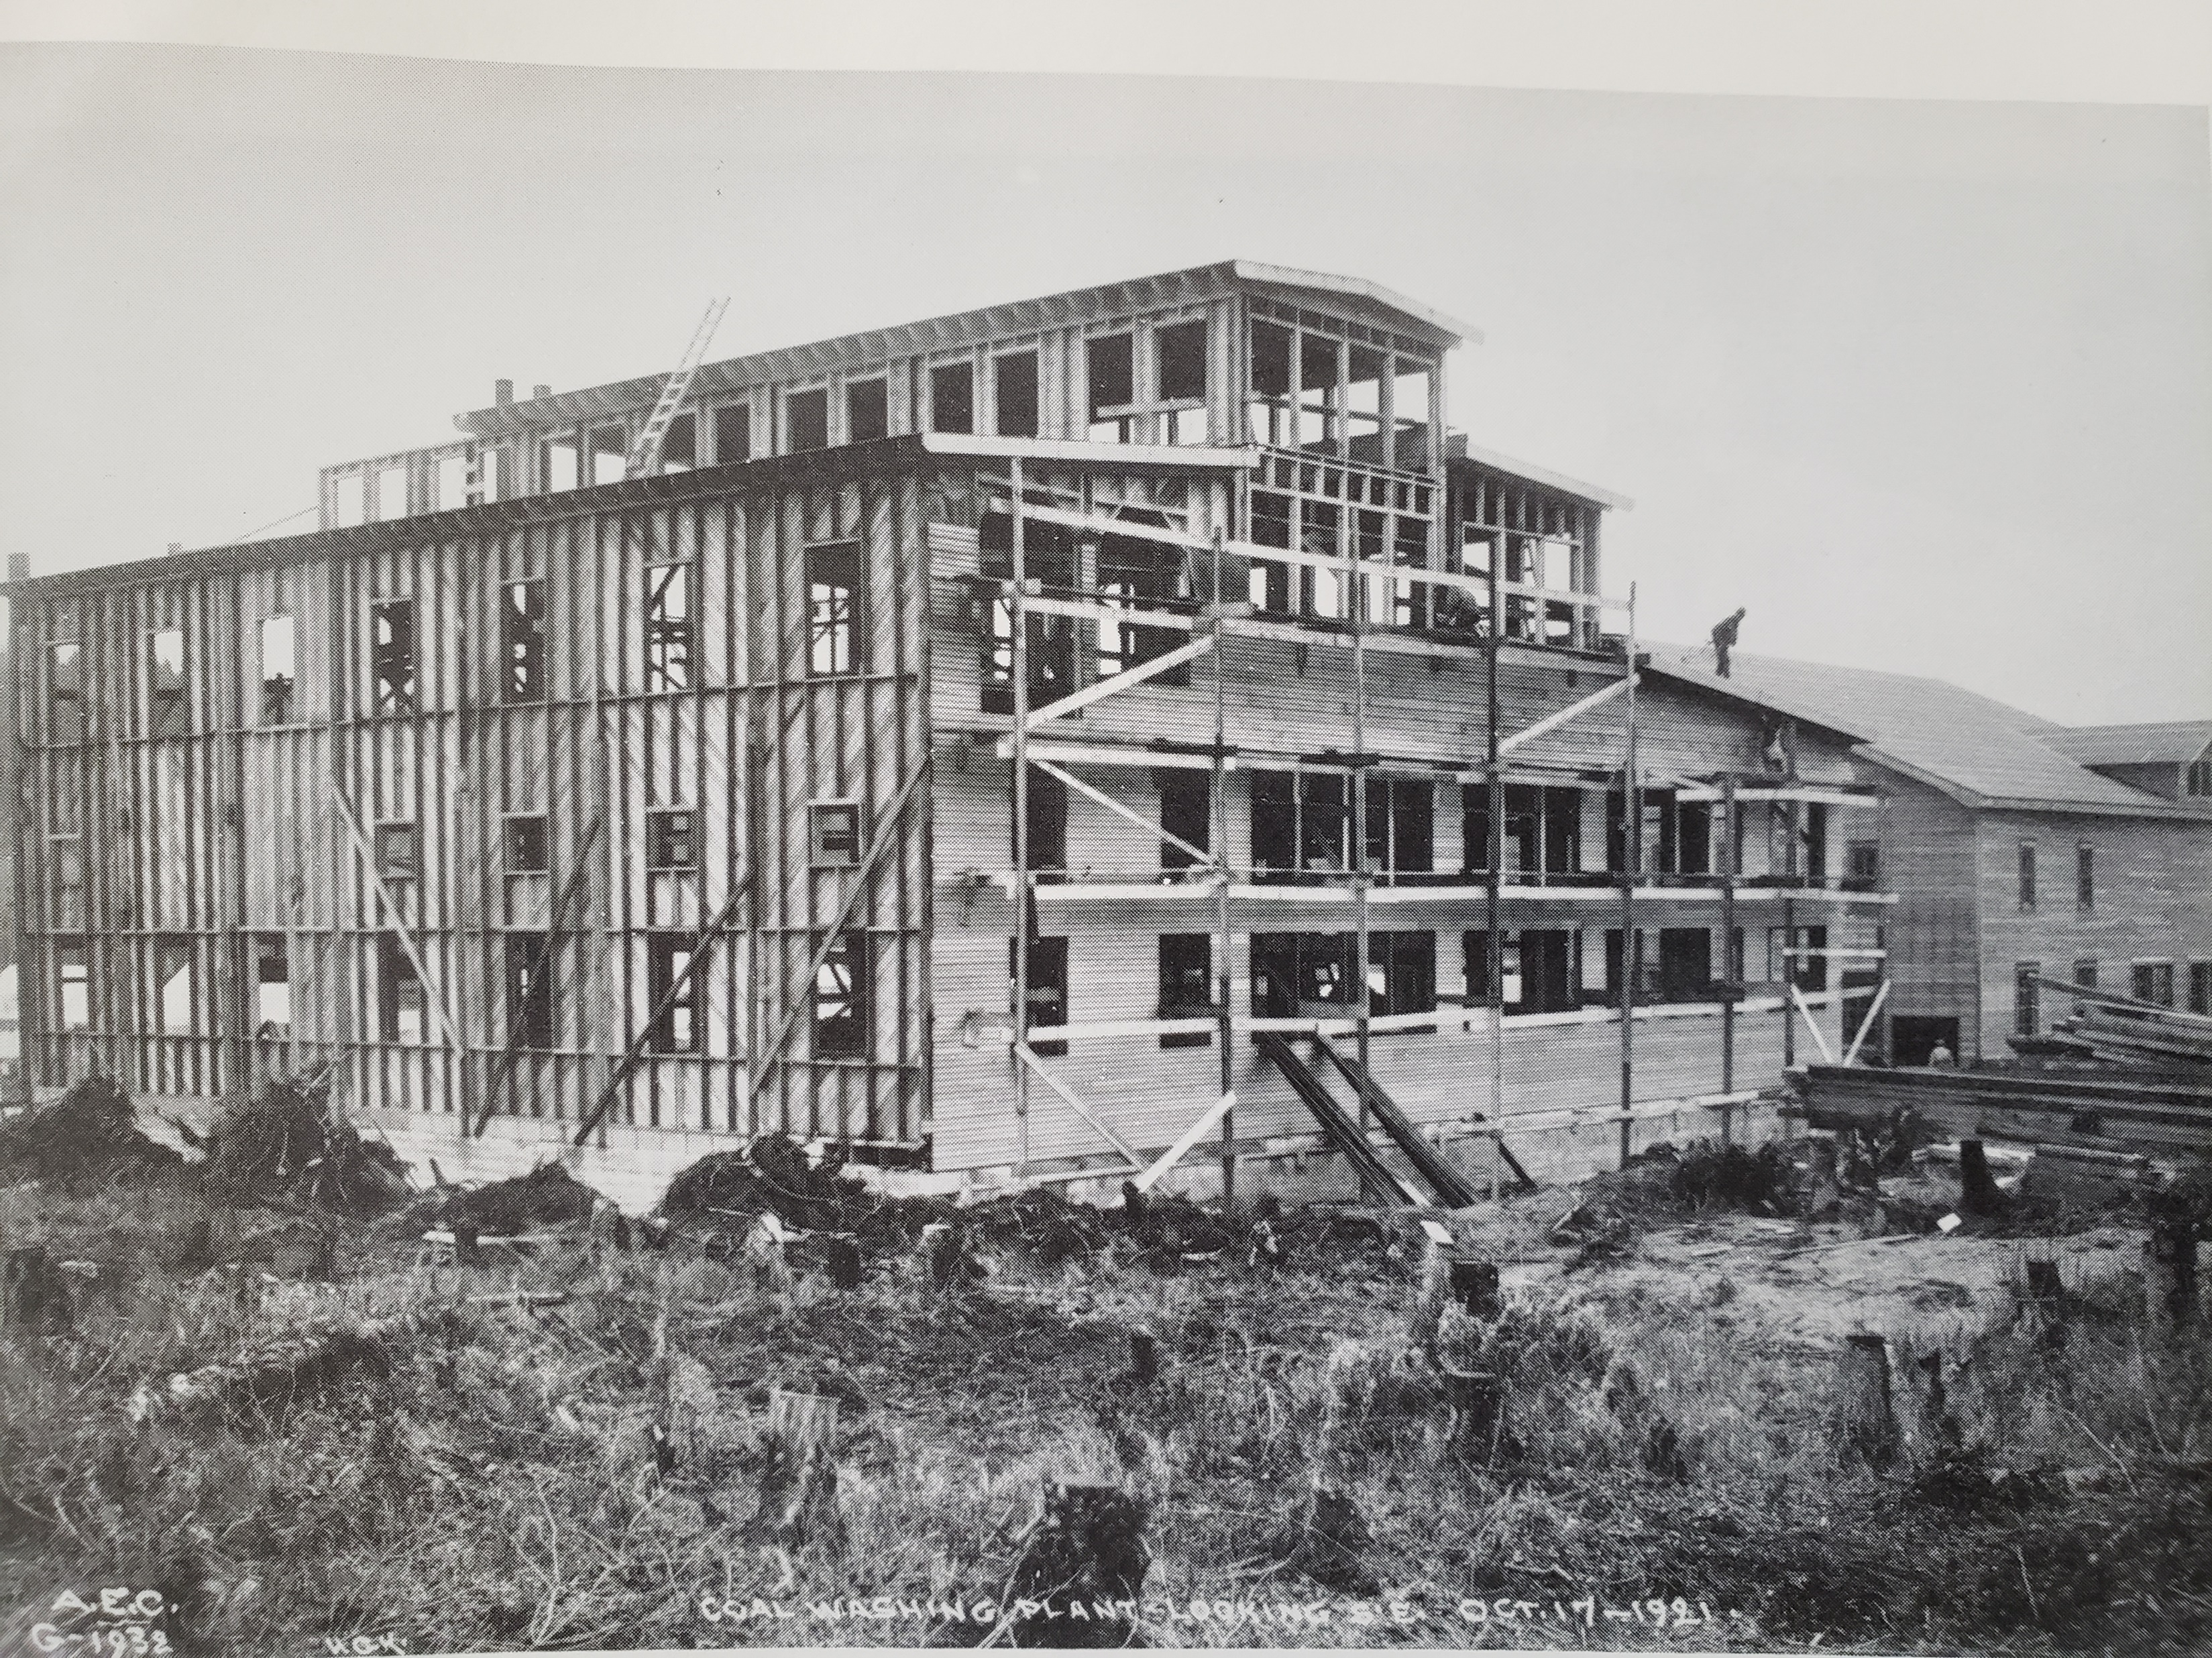
1915-1919: Alaska Railroad Progress
1915: Anchorage founded on Ship Creek near a Dena’ina fishing camp
1917: Wasilla townsite founded as station on the Alaska Railroad
1917: Eska Mine, the most productive coal mine in the Mat-Su Region begins operations.
1917: Alaska Railroad reaches Chickaloon
1918-1919: The location where the Eska railroad spur met the main line is named Sutton after a local homesteader
Coal washing plant, Sutton 1921, Alaska State Archives

Slide 15
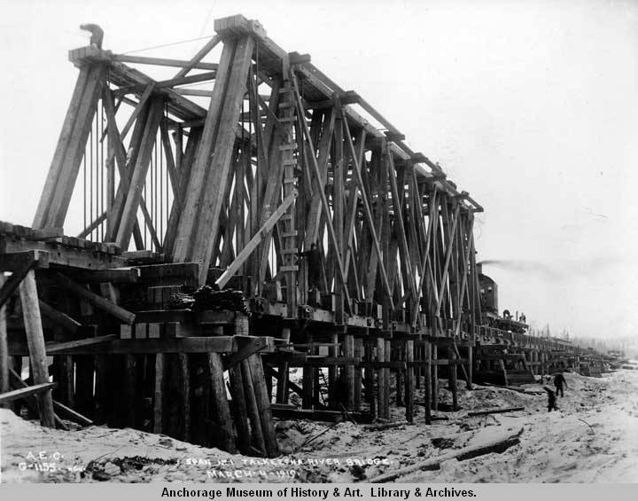
Early 1900’s: Talkeetna
Adjacent to a Dena’ina village, Talkeetna became the site of a steamer station along the Susitna River by 1910.
1916: Talkeetna designated as the Alaska Railroad’s divisional headquarters
1918: Talkeetna townsite auction
1918-1919: Many of Talkeetna’s Alaska Native population die of Spanish Flu
It wasn’t until 1964 that the construction of Talkeetna Spur Road connects the town to the road system.
Construction of Talkeetna River bridge, 1919. Anchorage Museum

Slide 16
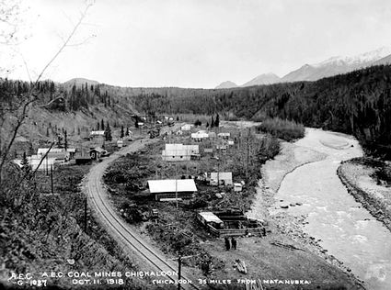
1917: Chickaloon, Railroad, Disease
The first Alaska Railroad train reaches Chickaloon on October 24, 1917.
That year, an influenza outbreak kills much of the local Ahtna population, a direct result of the increased settler presence.
Chickaloon 1918, USGS

Slide 17
1918-1919: Spanish Influenza
One of a series of disease outbreaks brought to Alaska by colonial settlers. As with previous and later outbreaks, Alaska Native people disproportionately suffered.
While Anchorage was quarantined for more than two weeks from late October into November 1918, and passenger trains were cancelled between Anchorage and Seward, construction on the Alaska Railroad in the Mat-Su Valley continued unabated.
Alaska Railroad Reporter headline, December 1918.

Slide 18
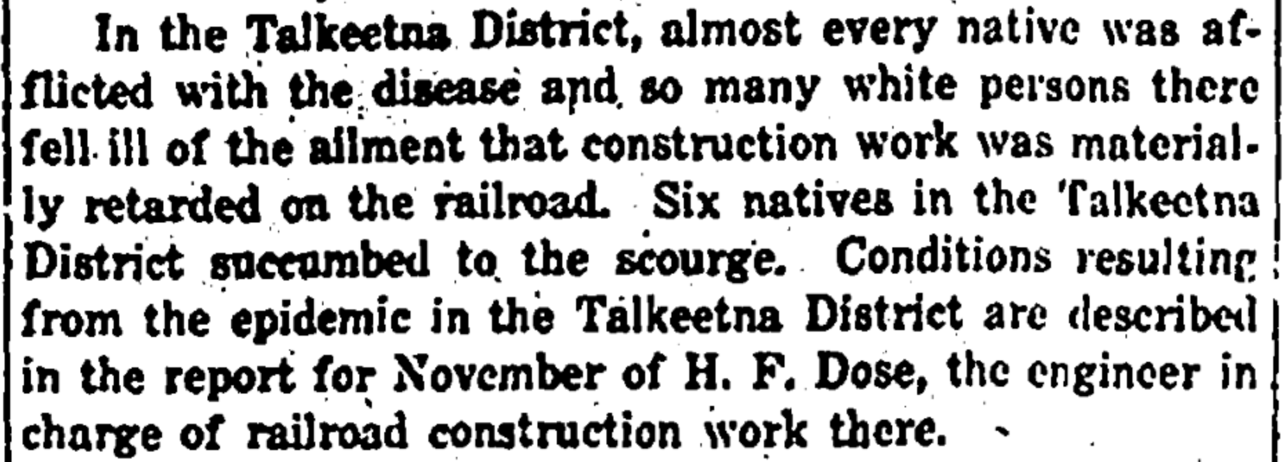
1918-1919: Spanish Influenza
According to Alaska Department of Health and Social Services (DHSS) research, 81.7% of all Alaska-wide Spanish Flu deaths were Alaska Native people.
DHSS data shows 23 deaths in the Mat-Su Valley, a number that greatly underestimates Alaska Native deaths.
Anchorage Daily Times, December 17, 1918.
Notes:
DHSS methodology relied upon death certificates. For Natives and other rural inhabitants of the Mat-Su region, their deaths would not have been counted unless documented by the Anchorage government hospital or railroad workers.

Slide 19
1918-1919: Spanish Influenza
“They went from village to village finding many of the villagers sick or dead from the flu. He told of rounding a bend and seeing a small boy standing on the bank sobbing. In the background the village appeared deserted. No smoke rose from chimneys, no children playing in the yards, and no campfires burned. The two men left Johnny to watch the young boy as they went through the village looking for survivors. They found none.”
Ingrid D. Shaginoff, Chickaloon Wild: End of an Athabascan Family’s Way of Life

Slide 20
1922-1923: End of Chickaloon Coal
On April 30, 1922, the U.S. Navy concluded that coal mining in Chickaloon was not worth the effort and handed oversight of mining operations there to the Alaska Engineering Commission.
On May 1, 1922, mining operations were suspended indefinitely.
By the end of 1923, Chickaloon was a ghost town. The buildings were torn down and shipped to Anchorage where they were used for new construction in Government Hill. Only unsalvageable debris was left in Chickaloon. The railroad tracks were removed in the 1930s.
“When they dismantled the houses in Chickaloon, they left most of the flooring and junk.”
Katherine Wickersham Wade, Chickaloon Spirit

Slide 21
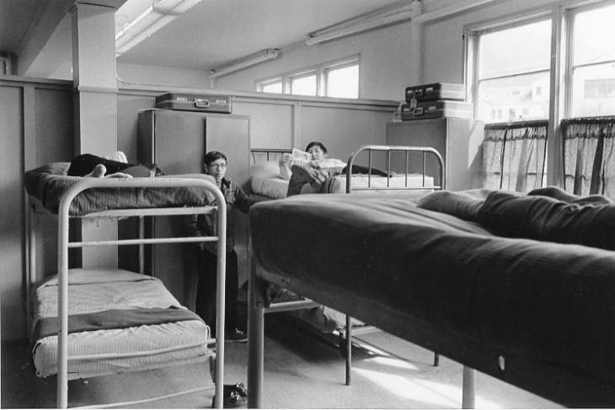
1800s-1900s: Boarding School System
Many Alaska Native children were forcibly enrolled in boarding schools that sought to assimilate them into colonial settler culture and erase Alaska Native culture.
It wasn’t until 2016 that Presbyterian officials apologize before the Alaska Federation of Natives for the church’s role in boarding schools.
Boys dorm, Mt. Edgecumbe boarding school, 1970, University of Alaska Anchorage

Slide 22
Rain Wade on the Boarding School Era
“My mother was born in 1922 and she was not sent away to boarding school but all of her brothers and sisters were.”
Notes:
Rain Wade is a member of Chickaloon Native Village and a resident of the Mat-Su Valley. In this clip she reflects on the boarding school era and its impact on her mother and her mother's siblings.

Slide 23
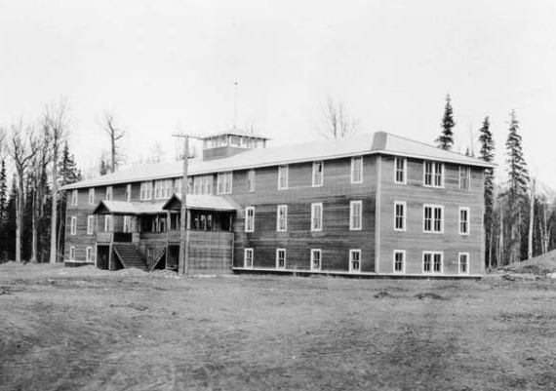
1930s-1950s: Boarding School System
The boarding school system was enforced by Territorial and federal officials in the Mat-Su region from the 1930s through the 1950s.
“A couple of years later they sent Helen and Billy to school down at Eklutna, left me out . . . They said a lot of times when they send some of those Indian kids to school, they lose their identity. They come back with their nose up in the air, they lose a lot of their original traditions.”
Eklutna Boarding School, circa 1930, University of Alaska Fairbanks
Katherine Wickersham Wade, Chickaloon Spirit

Slide 24
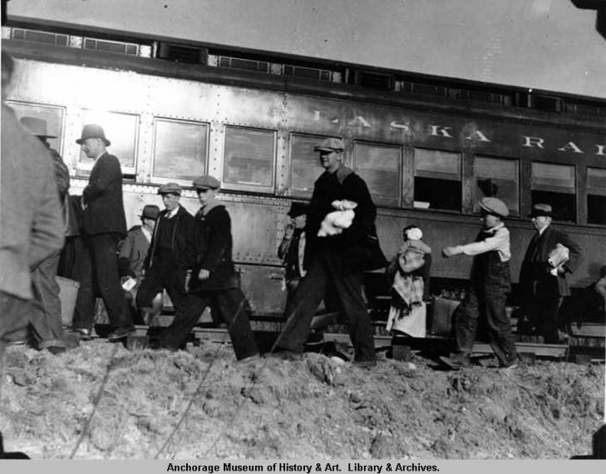
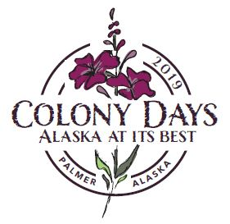
1935: Matanuska Colony Established
Without consulting Alaska Native people, the Department of Interior settled a group of white Minnesota farmers at modern-day Palmer.
Each family received a 40-acre plot.
From 1935 through the mid 1940s, attempts to similarly settle African American and Jewish colonists in Alaska are defeated by a combination of Congressional, Interior Department, and white Alaskan opposition.
The Colony is commemorated at annual events and place names in the Mat-Su.
Colonists arrive in Matanuska, 1935, Anchorage Museum

Slide 25
Lisa Wade
on Colony
"The word colony, in our community, permeates everything."
Notes:
Lisa Wade is a member of Chickaloon Native Village and a resident of the Mat-Su Valley. In this audio clip she talks about the way racism is structured into our vocabulary and our place names.

Slide 26
Late 1930s: Polio epidemic
As originally planned and implemented, the Matanuska Colony did not include any federally provided medical services. Within two months of the colonists' arrival, polio and other infectious diseases had become epidemic within the colony and quickly spread through the Mat-Su region.
“The Indian Health Service was sending Native people away when they got polio. No one knew where they were sent. Many were never heard from again.”
Ingrid D. Shaginoff, Chickaloon Wild: End of an Athabascan Family’s Way of Life

Slide 27
1900s: Destruction of Culture and Language
“Every time a Public Health nurse visited an area or a family, she always stressed the importance of speaking English. Families were warned to not allow the children to speak their Native language.”
“I hope the game situation has improved around Chickaloon . . Neither of them have gotten a moose or even heard of anyone getting one.”
“The new law also required a Native to have a certificate signed by five white people . . . stating that the Native had adopted ‘civilized behavior.’ Mary knew of no Native who had ever been able to meet these requirements.”
Ingrid D. Shaginoff, Chickaloon Wild: End of an Athabascan Family’s Way of Life

Slide 28
1935: Resident Hunting Permits Required
In 1935, the Territorial Game Commission began requiring resident hunting permits. As restrictions grew in number and exclusivity, many aspects of a subsistence lifestyle became illegal.
“The white guys went home and Johnny went to jail [for hunting out of season]. He was sentenced to three months which he was to serve in the tiny jailhouse in Palmer.”
Ingrid D. Shaginoff, Chickaloon Wild: End of an Athabascan Family’s Way of Life

Slide 29
1952: Anti Native Signage
“As [Talkeetna] grew and others like it along the railroad, signs popped up in windows and on doors stating, ‘No Natives and No Dogs,’ or ‘No Native Trade Wanted.’ These signs were present at bars, restaurants, theaters, barbershops and bath houses up and down the line.”
Ingrid D. Shaginoff, Chickaloon Wild: End of an Athabascan Family’s Way of Life
“Prefer white adults. No dogs.” classified, Anchorage Daily Times, 1952

Slide 30
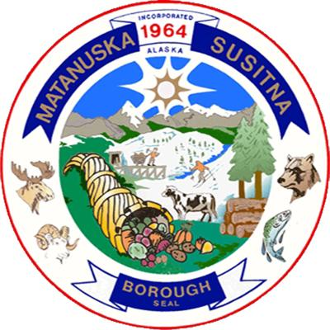
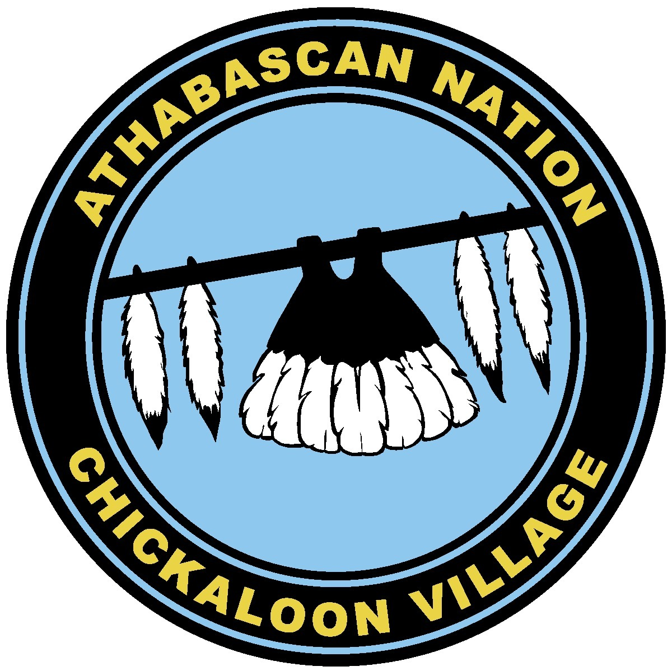
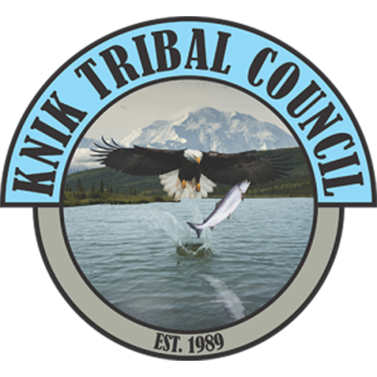
1964-89: Tribal + Borough Governments Established
1964: Matanuska-Susitna Borough incorporated, leading to confrontations over taxation of Alaska Native people in region.
1973: Residents establish the sovereign Chickaloon Village Traditional Council in 1973, federally recognized the same year.
1989: Knik Tribal Council federally recognized.

Slide 31
Racism Persists – through Government Systems
1991: Newly elected Alaska Governor Wally Hickel nominated fundamentalist Talkeetna pastor Jack Phelps to the state board of education. The previous year, Phelps wrote in the church newsletter of his support for former Ku Klux Klan Grand Wizard David Duke, then a Louisiana politician. Phelps was subsequently rejected for the position by a state House committee.
2006: At an Alaska Board of Game meeting in Wasilla, Somerville, then Chairman of the AK Board, made several derogatory remarks regarding Alaska Natives.Referring to Alaska Natives who missed the meeting, Somerville said, "There must have been a run on free beer.“
2016-2019: David Eastman, elected in 2016 to the Alaska House of Representatives for the 10th District (Mat-Su Borough), said women in Alaska “try to get pregnant” for a “free trip to the city.” Reelected in 2018, In 2019 Eastman only Representative to vote against Black History Month

Slide 32
Racism Persists – in Mat-Su Schools
Two African American families filed complaints about discrimination at Palmer High School.
In response, the Anchorage Daily News interviewed Mat-Su area high school students. Some of their responses:
“They call me, ‘Hey, Native’ or ‘Hey, n-----,’ and I'm not even black. Like just the things they say to me are, like, I think are racist. But I'm not, like I'm so used to it that I'm not offended by it anymore.
Jamie Christensen, Colony High School
“I believe a lot of people discriminate against Alaska Natives. I mean there's just so many jokes always flying around ... like the stereotypes of them all being drunks is one.”
Dmitry Muzechuk, Wasilla High School

Slide 33
Racism Persists – in Mat-Su Workplaces
In 2008, the day after MLK Day, African American MEA employee Donte Kelly discovered a noose placed on his desk. The coworker who placed the noose was later promoted to be his supervisor.
This was the latest in a series of racial incidents experienced by Kelly including racial comments and a failure to promote.
Kelly filed a discrimination lawsuit against MEA in 2009 with an unknown outcome.

Slide 34
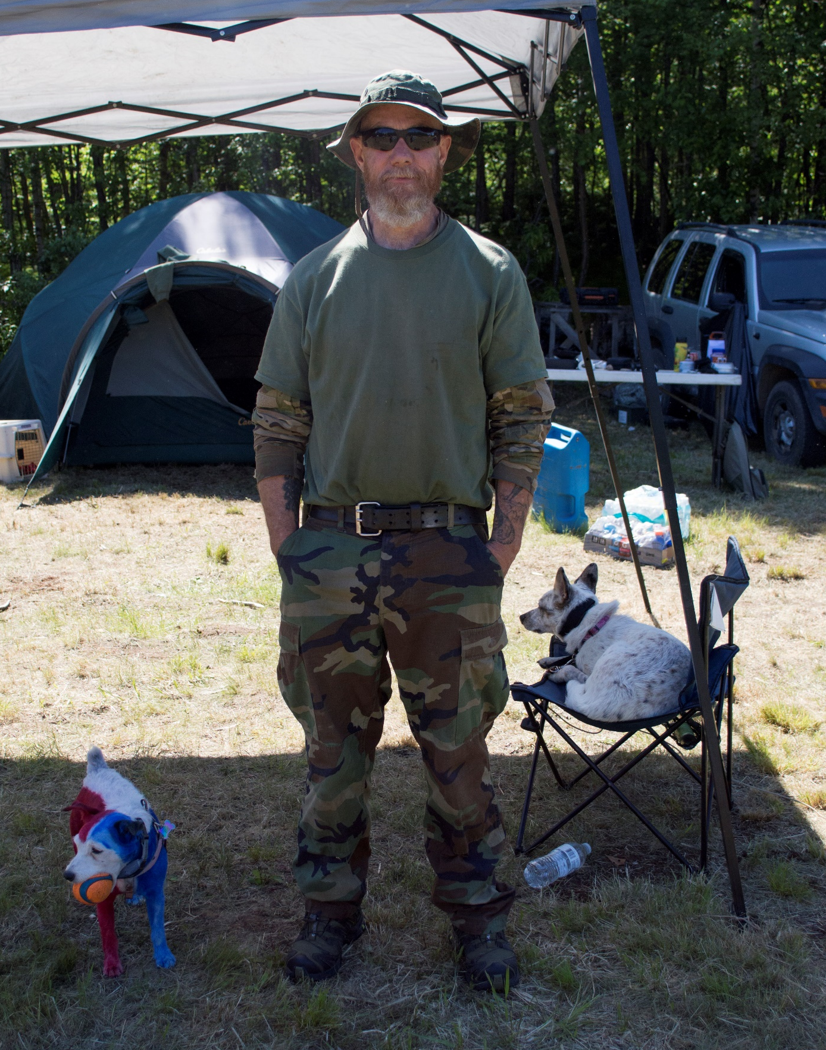
1980-2020: Rise of Militia/Hate Groups in Mat-Su
1980: Former Ku Klux Klan Grand Wizard David Duke attempts to create a National Association for the Advancement of White People based in Anchorage
2020: Southern Poverty Law Center lists four hate groups and ten other anti-government militia groups in Alaska, including the prominent South Central Patriots based in Wasilla.
South Central Patriot leadership admits to infiltrating social justice demonstrations such as Black Lives Matter rallies.
John Root, founder South Central Patriots, Southern Poverty Law Center

